Slide 1
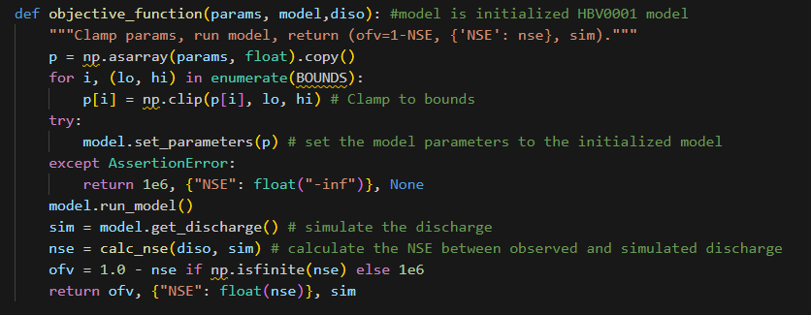
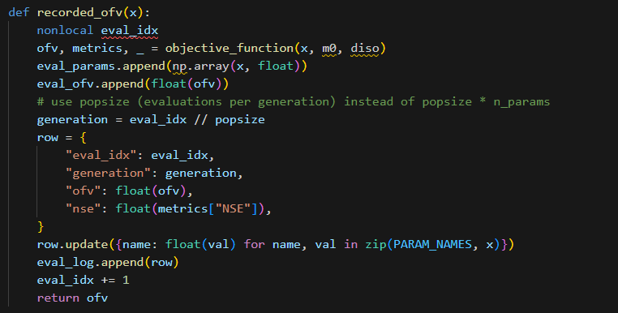
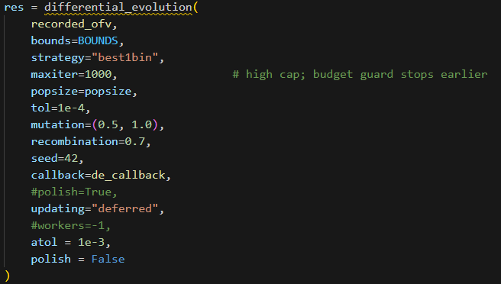
All Parameters on

Slide 2
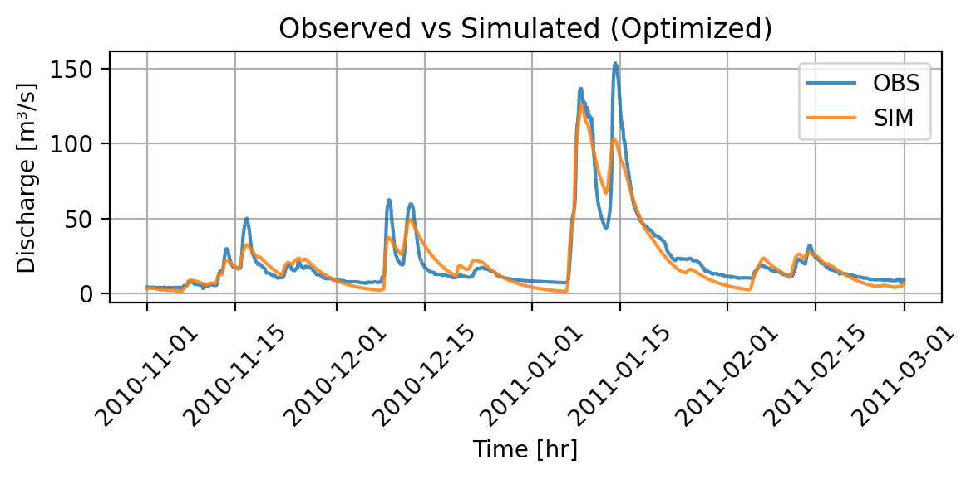
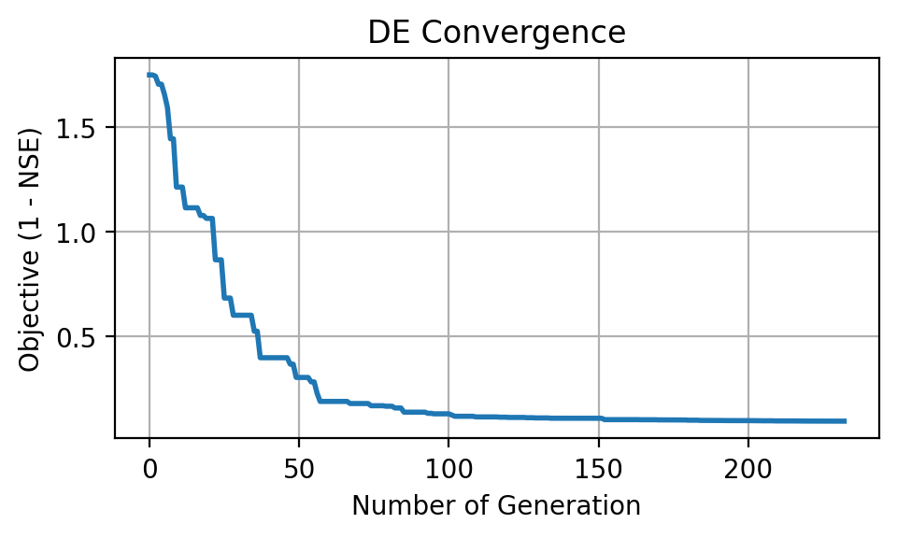
All Parameters on
NSE: 0.901
Runtime: 3.74 min
Max iteration: ~ 100

Slide 3
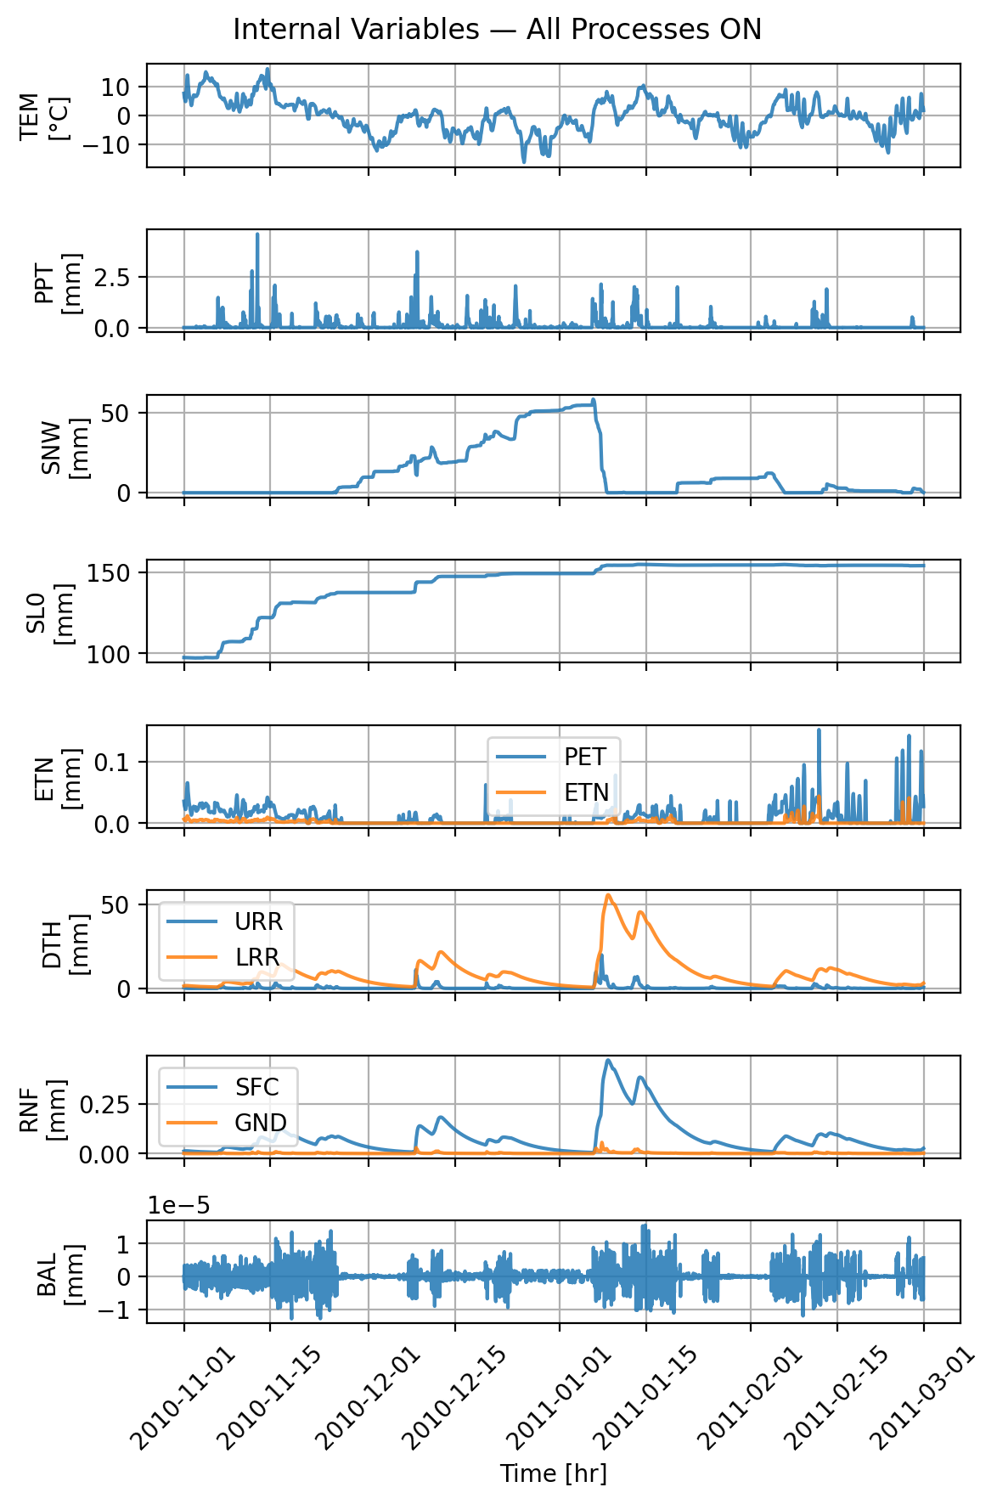
All Parameters on
Snow initial depth: 0.000000
Snow fall/melt temperature: 0.148940
Snow melt air factor: 0.634415
Precipitation melt air factor: 0.036731
Soil initial moisture: 94.568525
Soil permanent wilting point: 432.979200
Soil field capacity: 148.866130
Soil beta: 2.659653
Storage initial upper reservoir: 1.728010
Storage initial lower reservoir: 0.739939
Upper-res. runoff split ratio: 0.748241
Percolation coefficient upper-to-lower: 0.185272
Upper-res. threshold depth: 60.579322
Upper-res. threshold coefficient: 0.143289
Upper-res. discharge to runoff coefficient: 0.000401
Upper-res. Runoff coefficient: 0.000147
Discharge rate: 0.008535
Lower-res. runoff coefficient: 0.000024

Slide 4
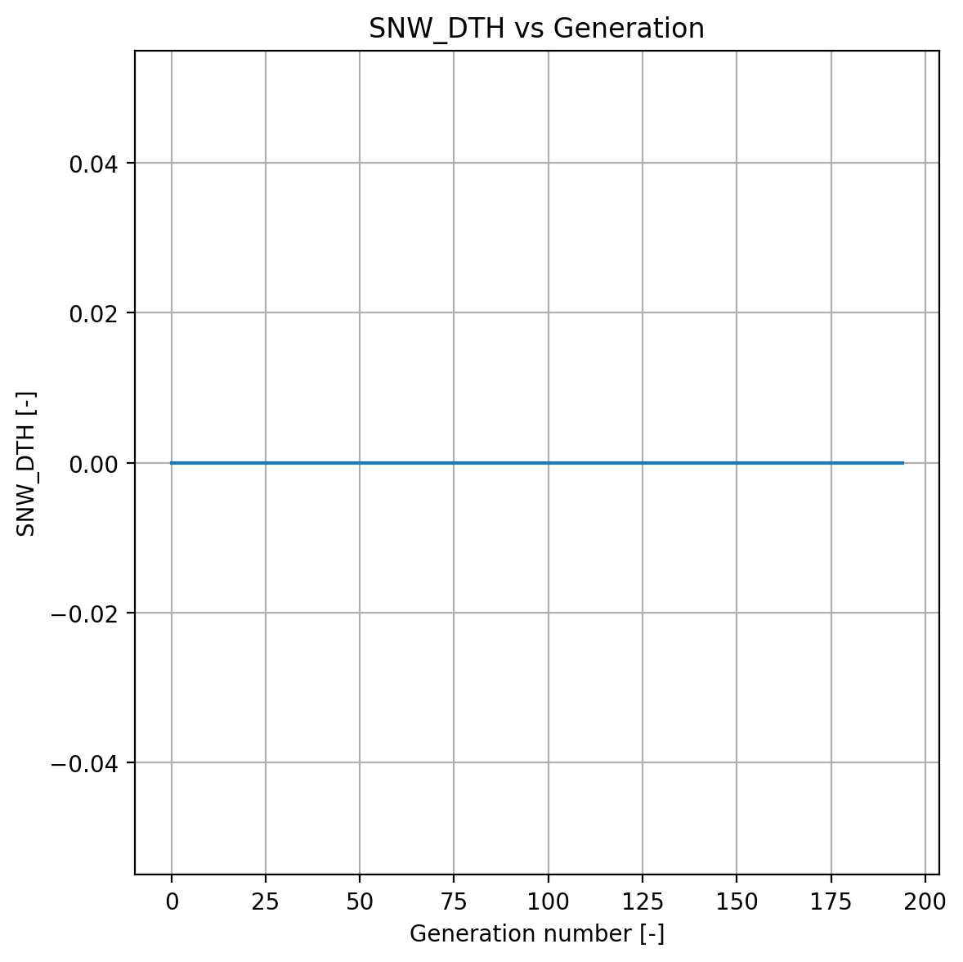
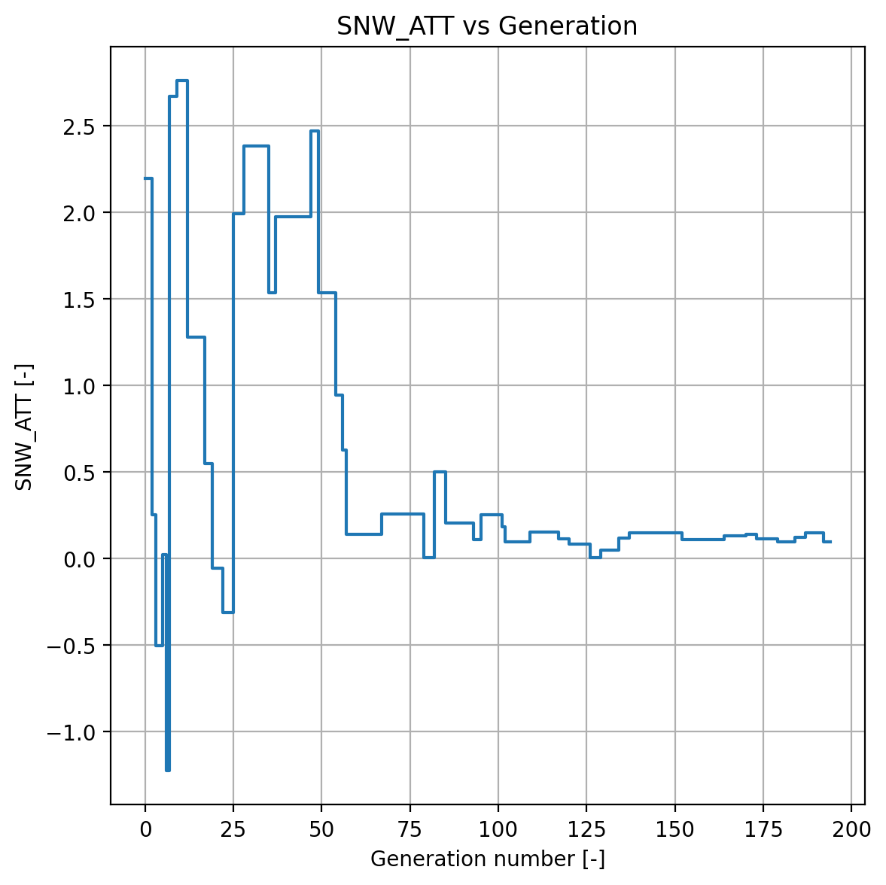
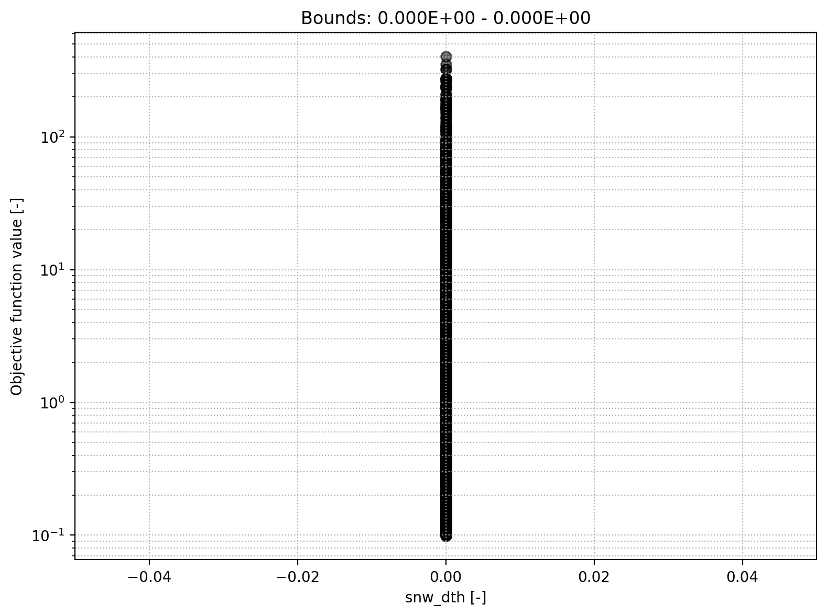
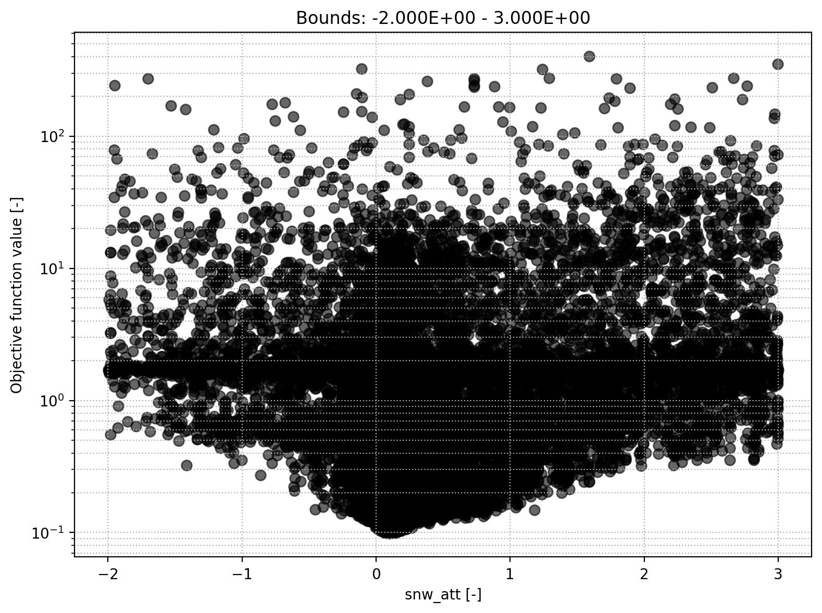
Snow module
Snow initial depth
Snow fall/melt temperature threshold

Slide 5
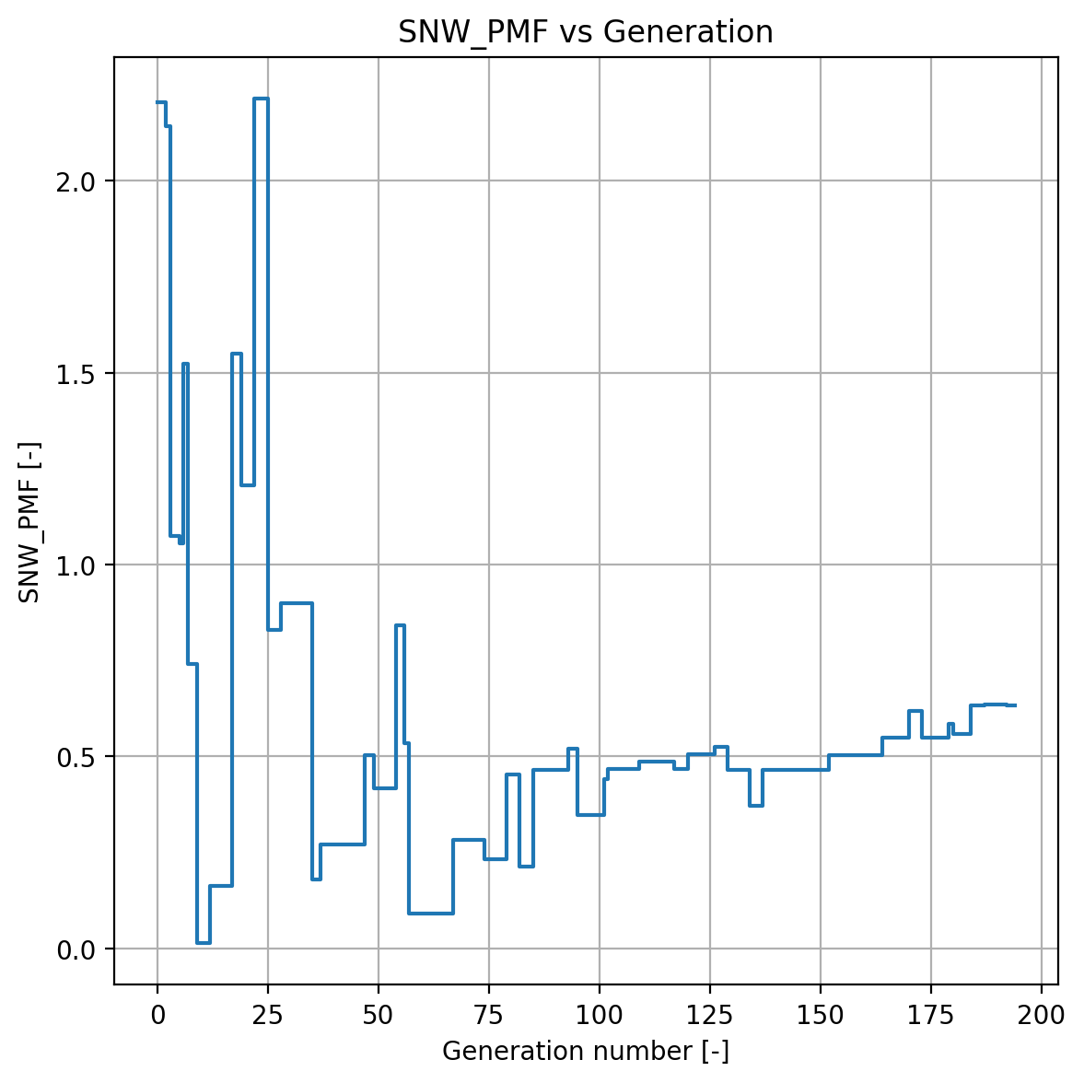
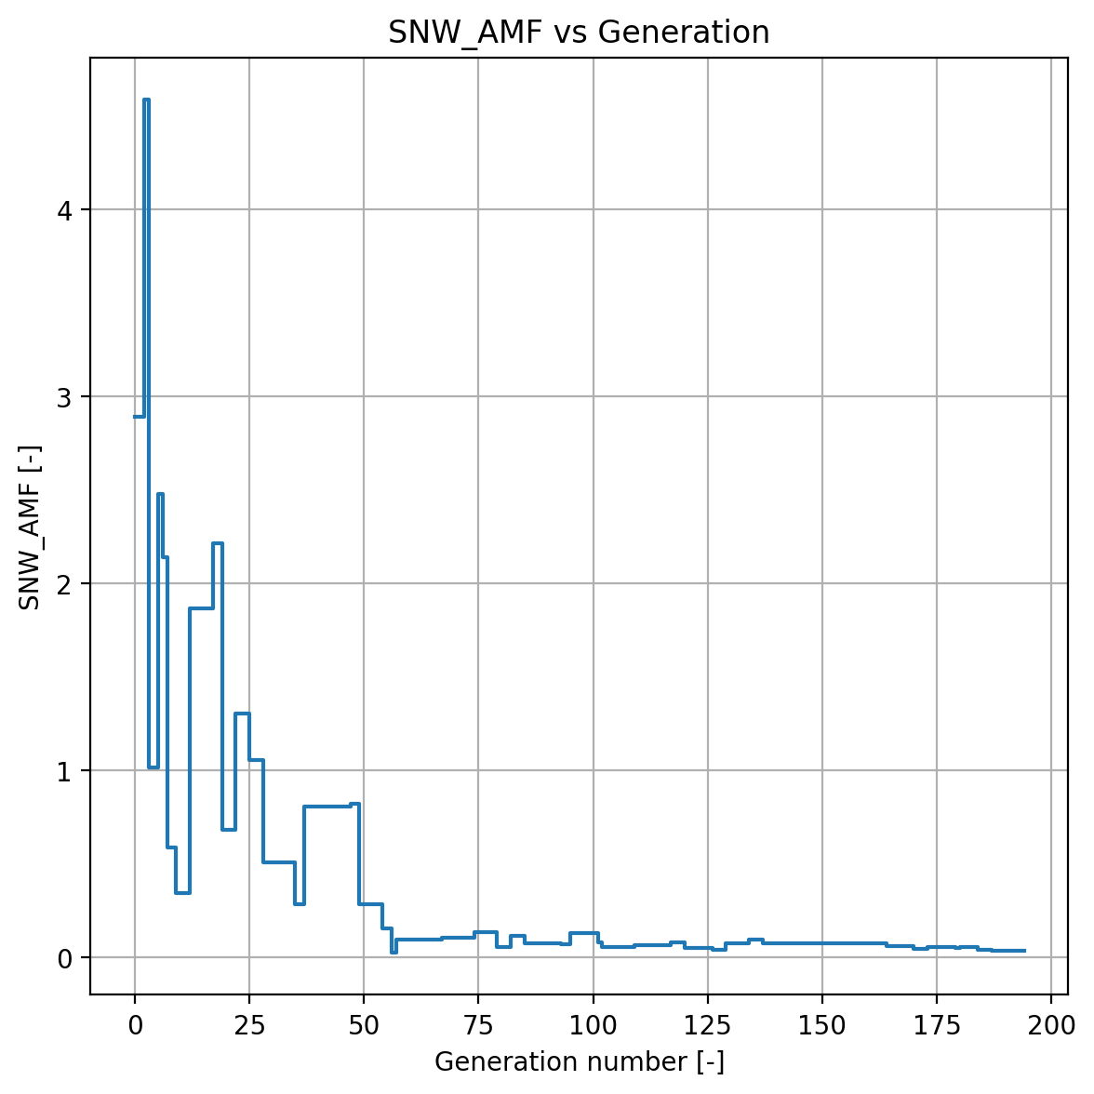
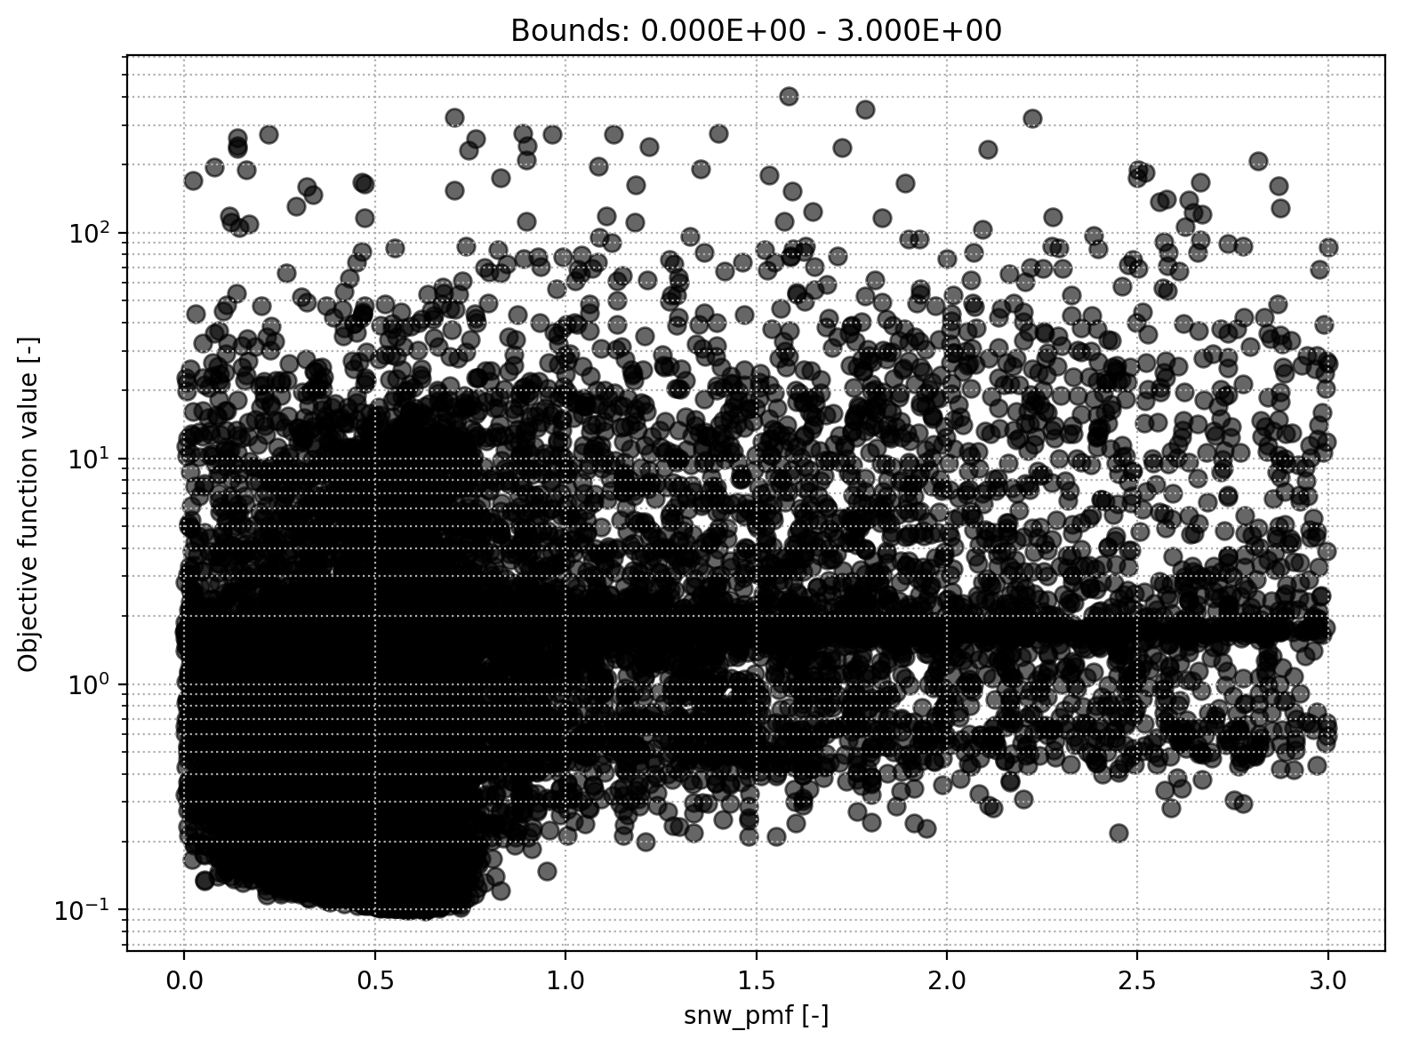
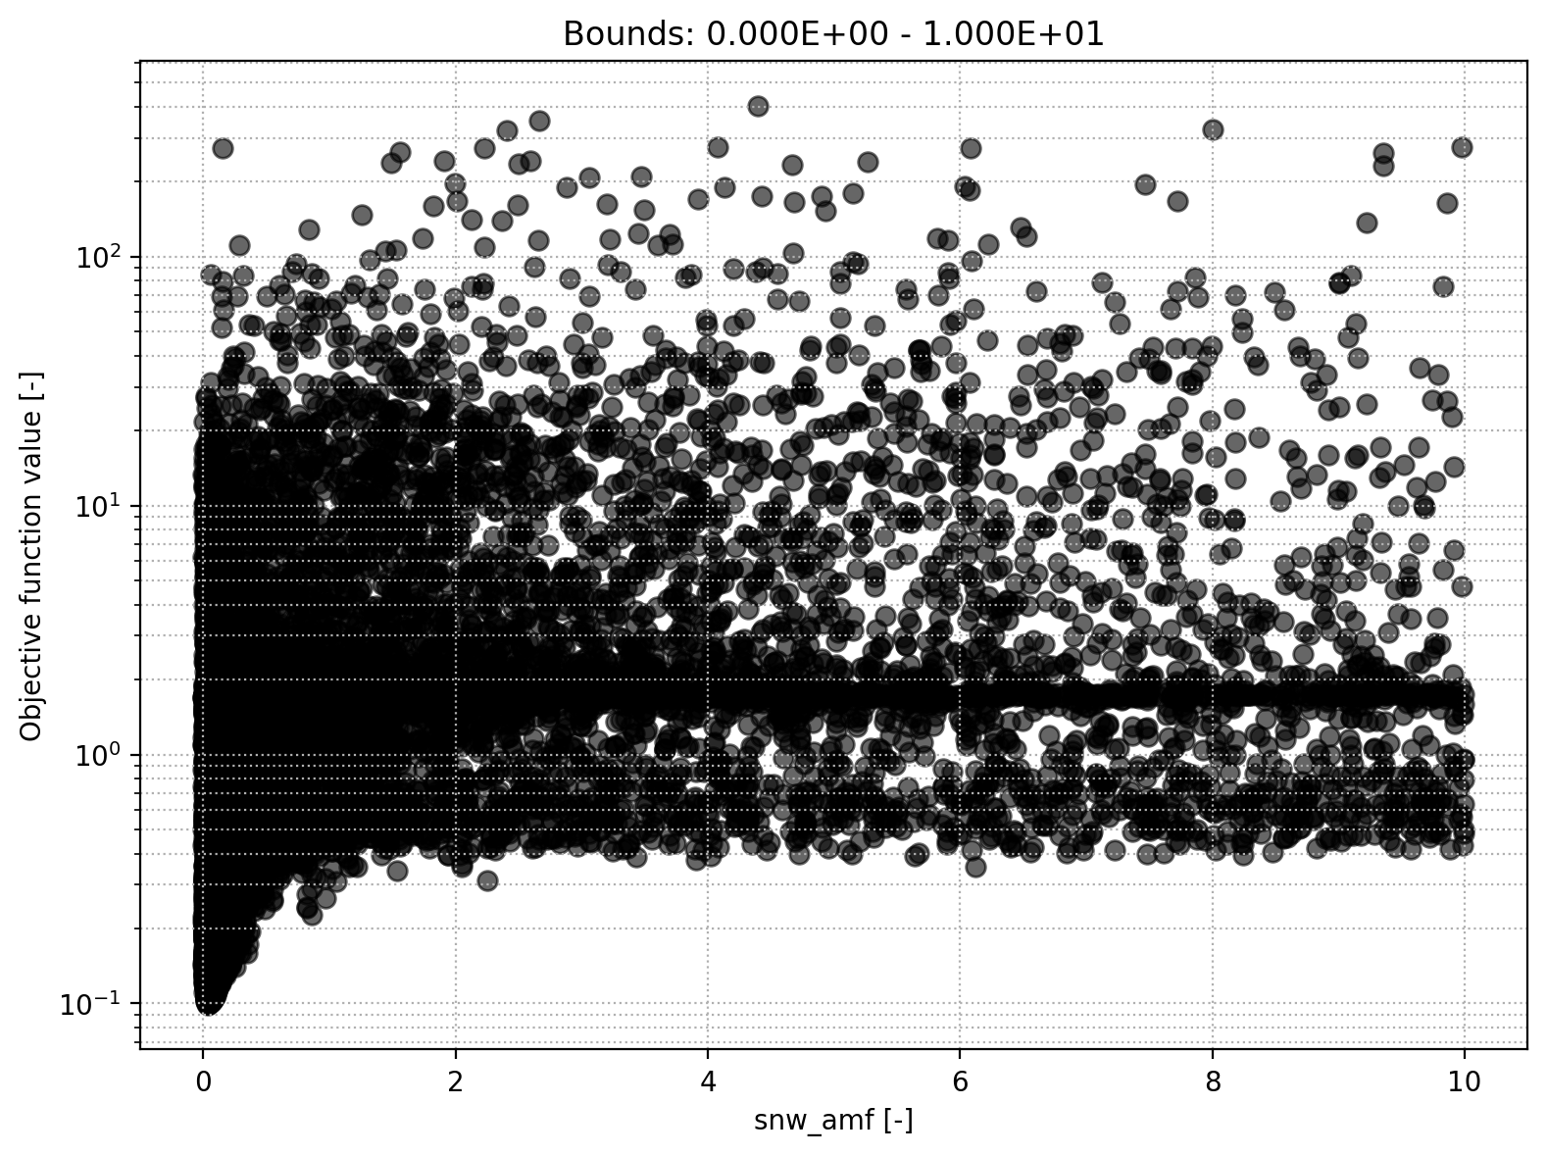
Snow module
Snow melt air factor
Precipitation melt air factor

Slide 6
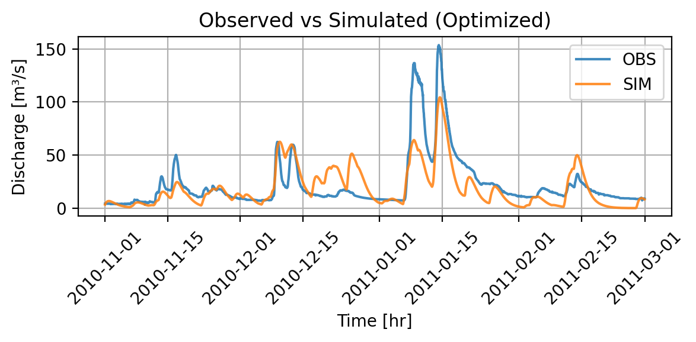

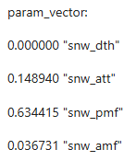
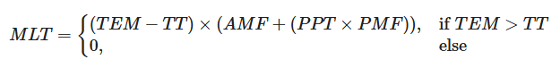
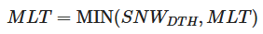
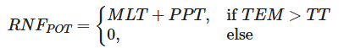
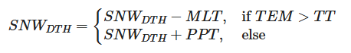
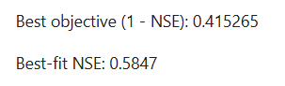
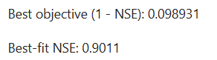
Snow module off – optimization Part 1
We set TT = -100°C
We set AMF = PMF = 0
Adapt bounds and run optimization
Simulated Discharge – snow modul off
Simulated Discharge – all modules on

Slide 7
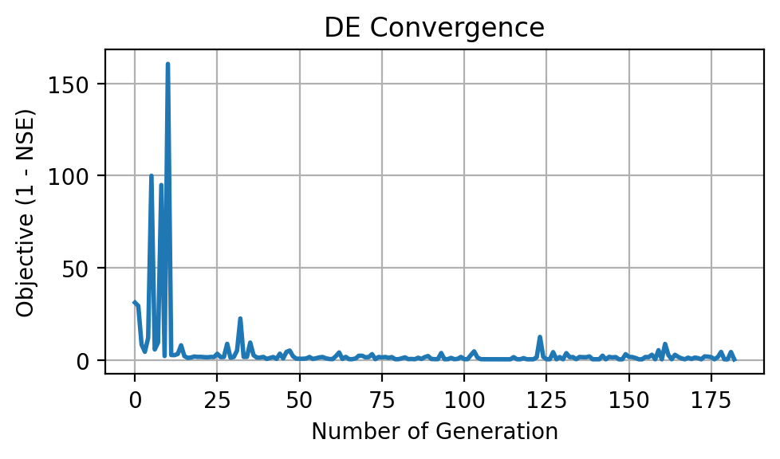
Snow module off – optimization Part 2
Schenkenau in Bavaria -> We expect melt
Less peaky as melt implies higher runoff
Interesting behavior (snow then no snow at fast melt)
High OFV
Poor convergence
Conclusion: Snow module relevant

Slide 8
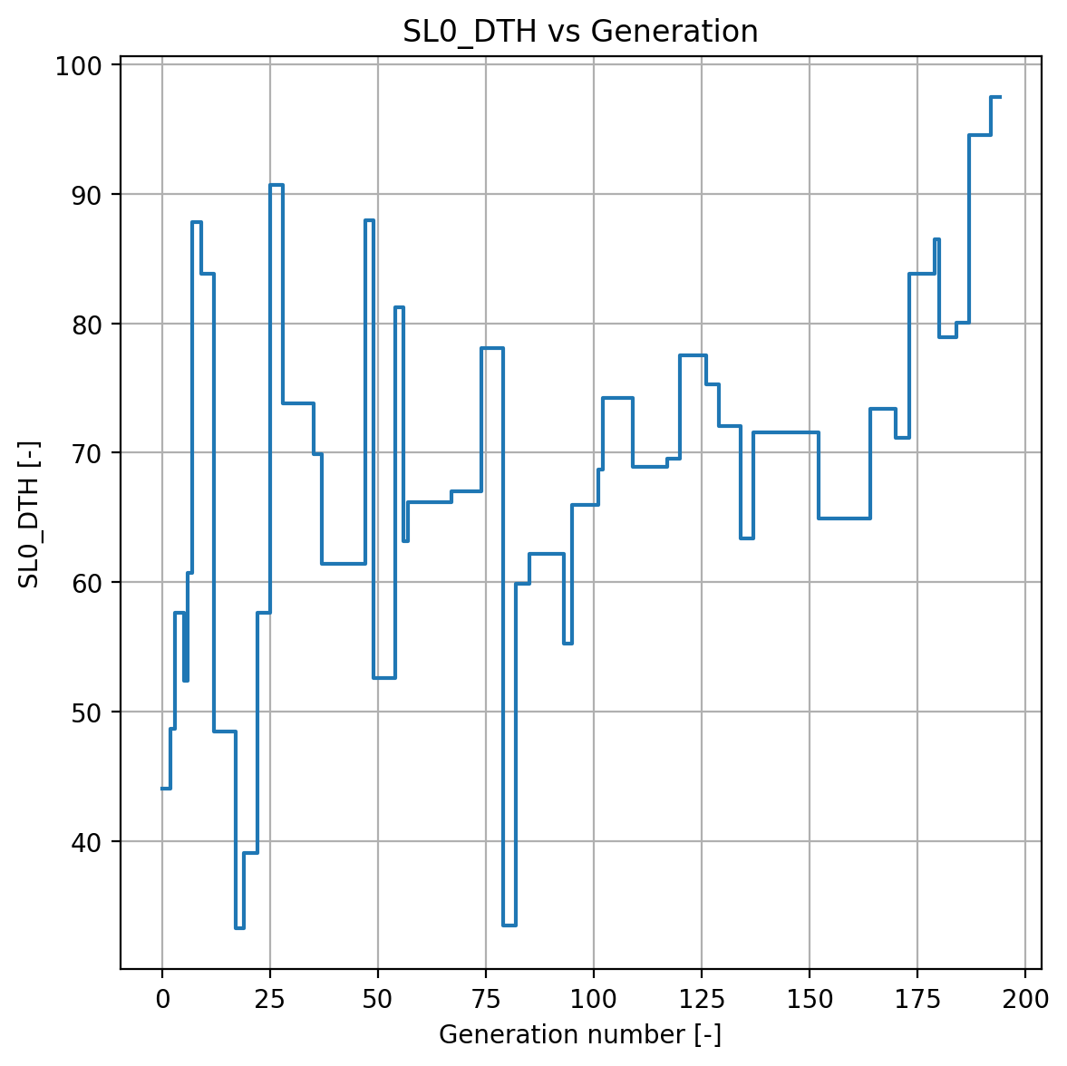
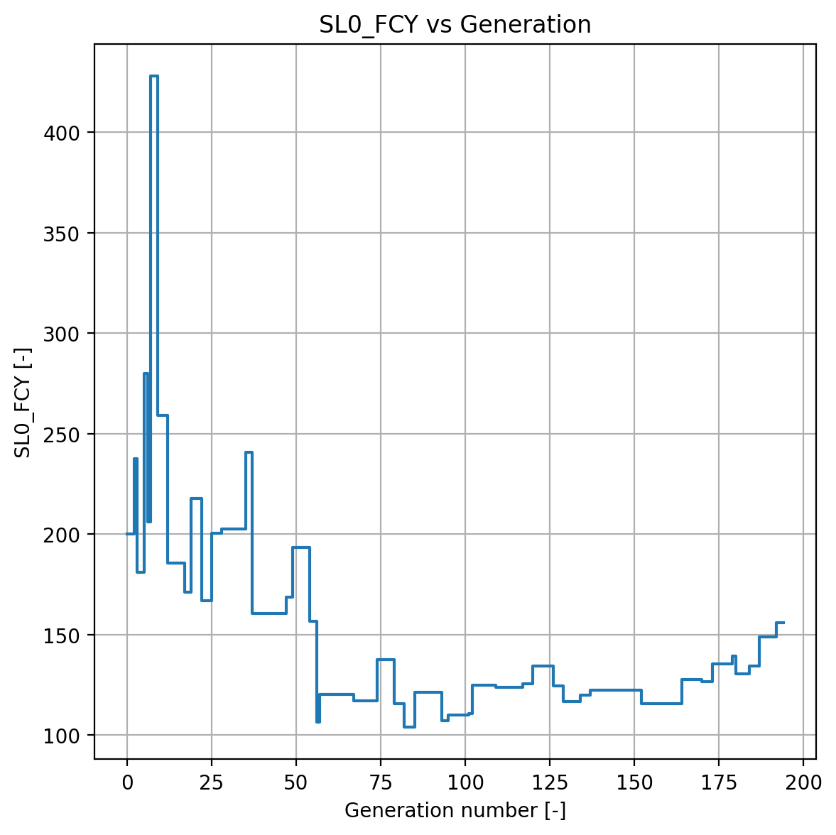
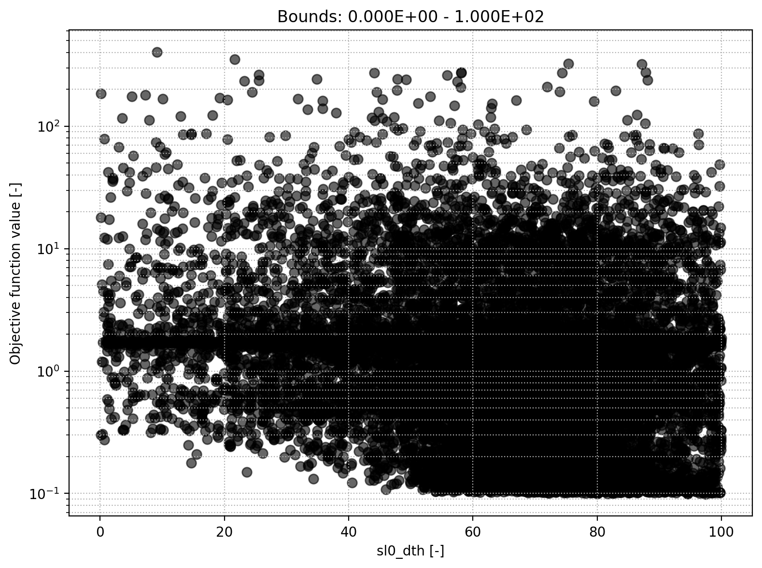
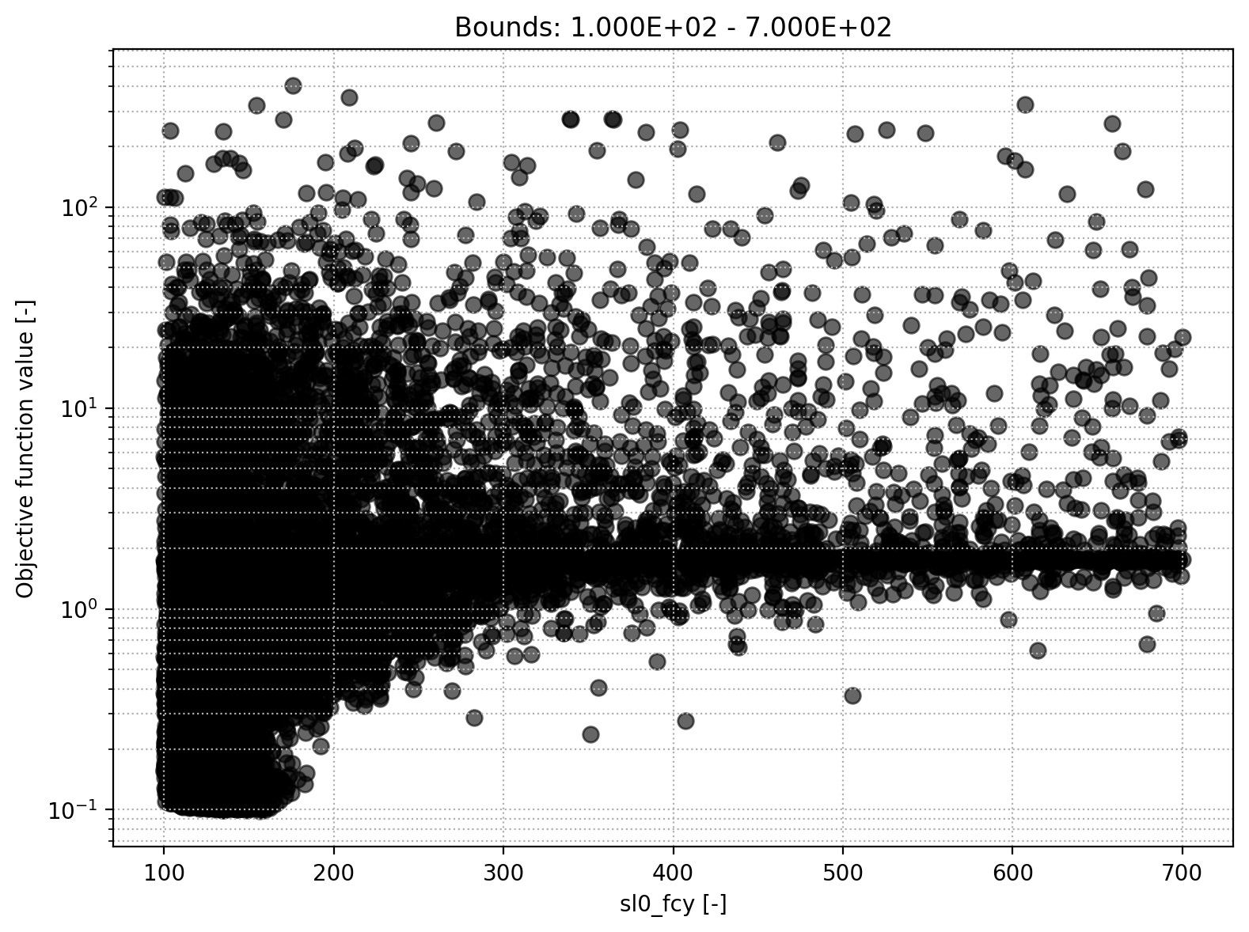
Soil module
Soil initial moisture
Soil field capacity
Soil permanent willting point
Soil beta

Slide 9
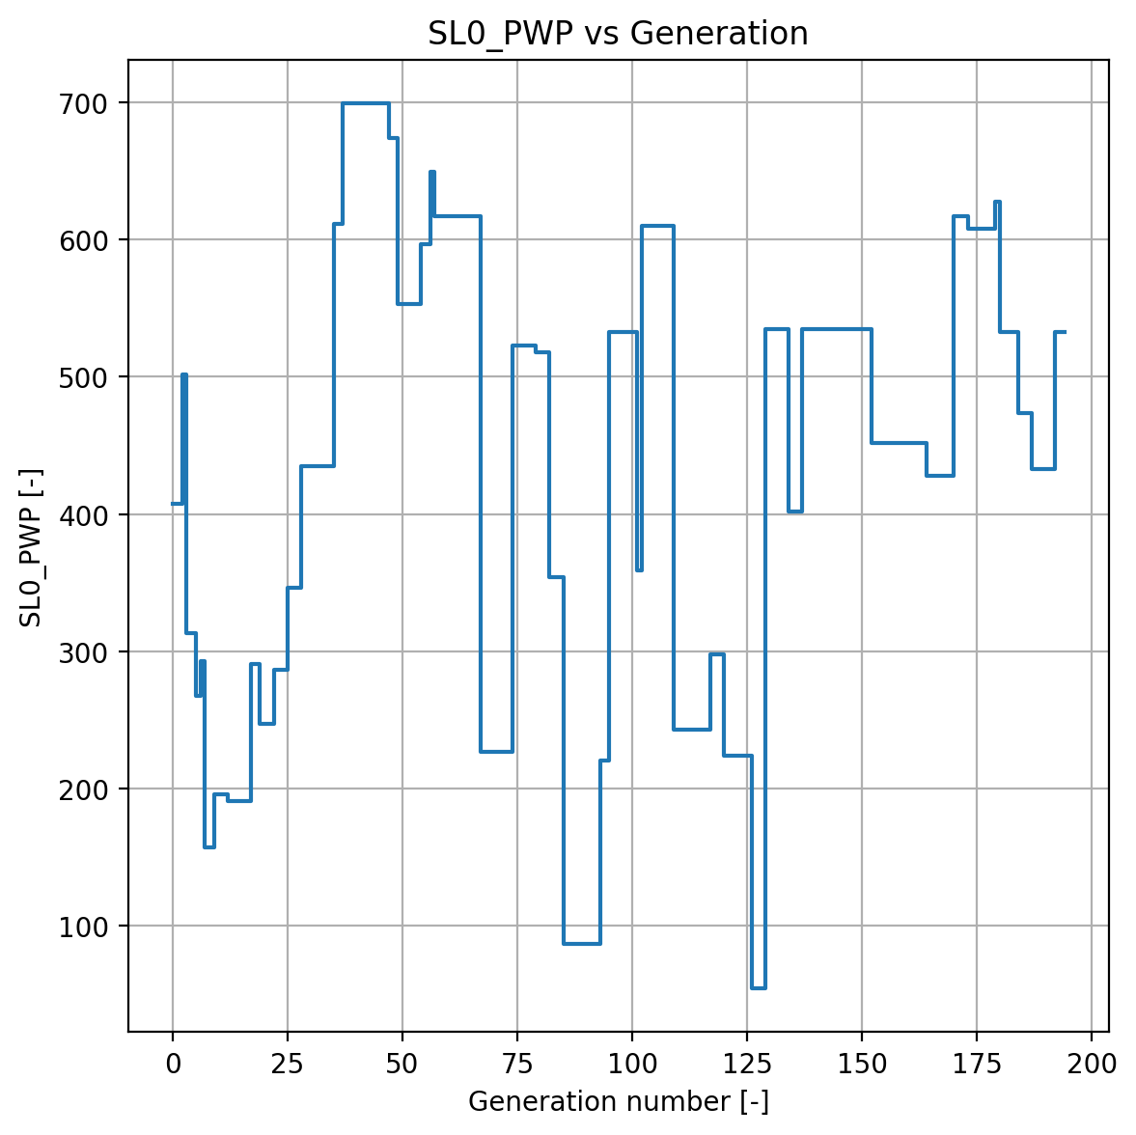
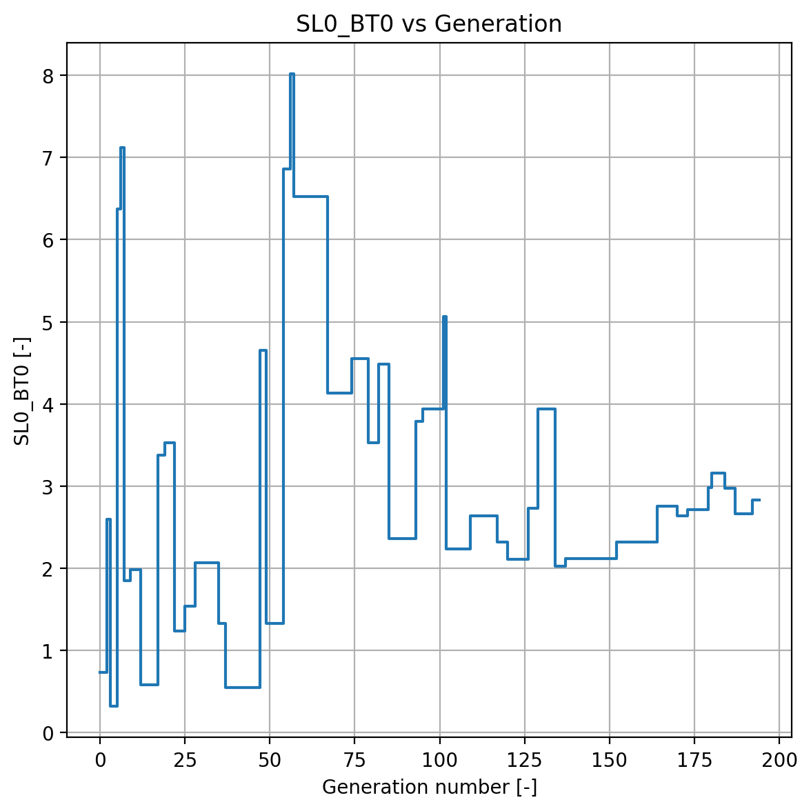
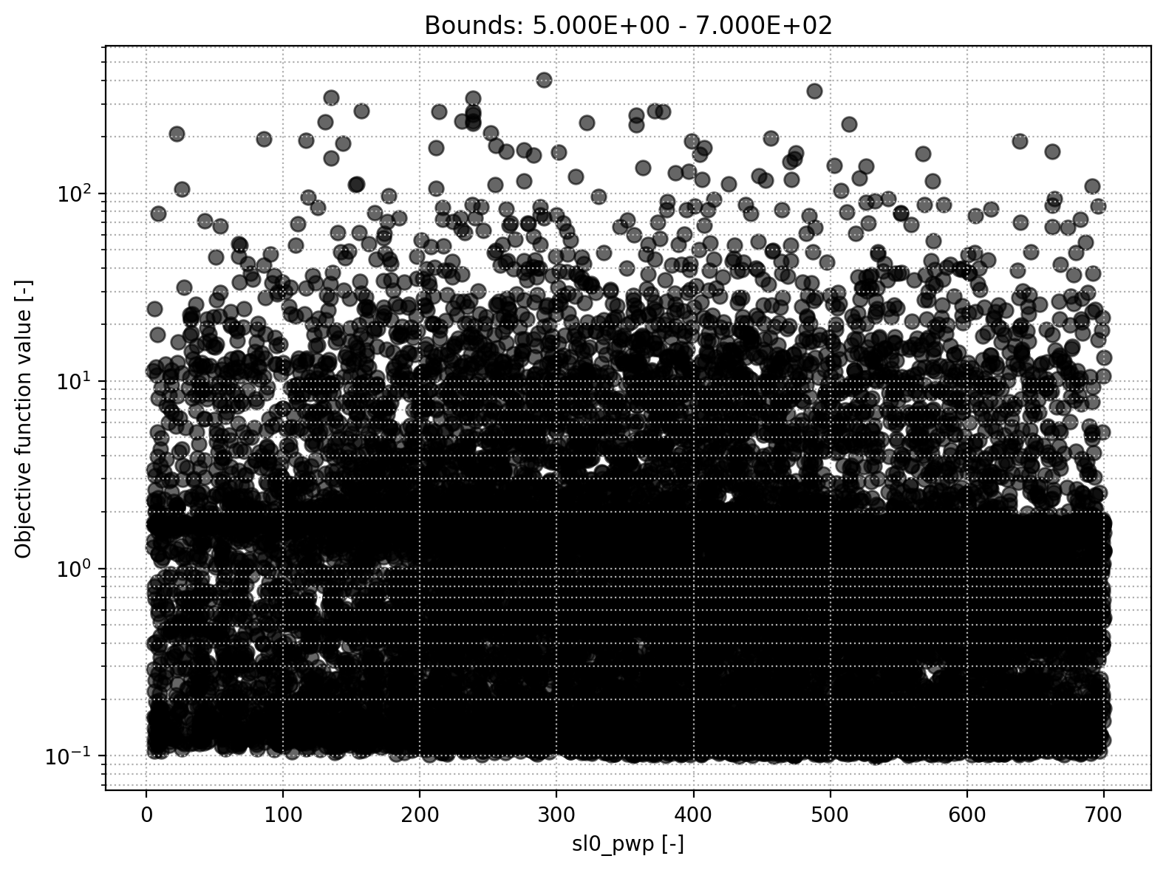
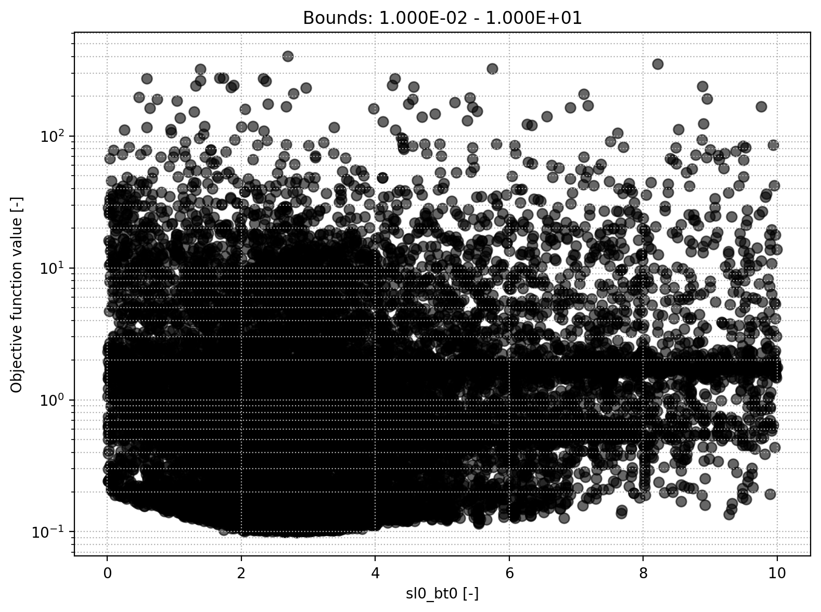
Soil module
Permanent wilting point
Soil beta

Slide 10
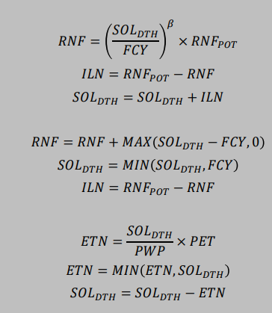
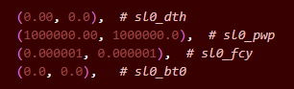
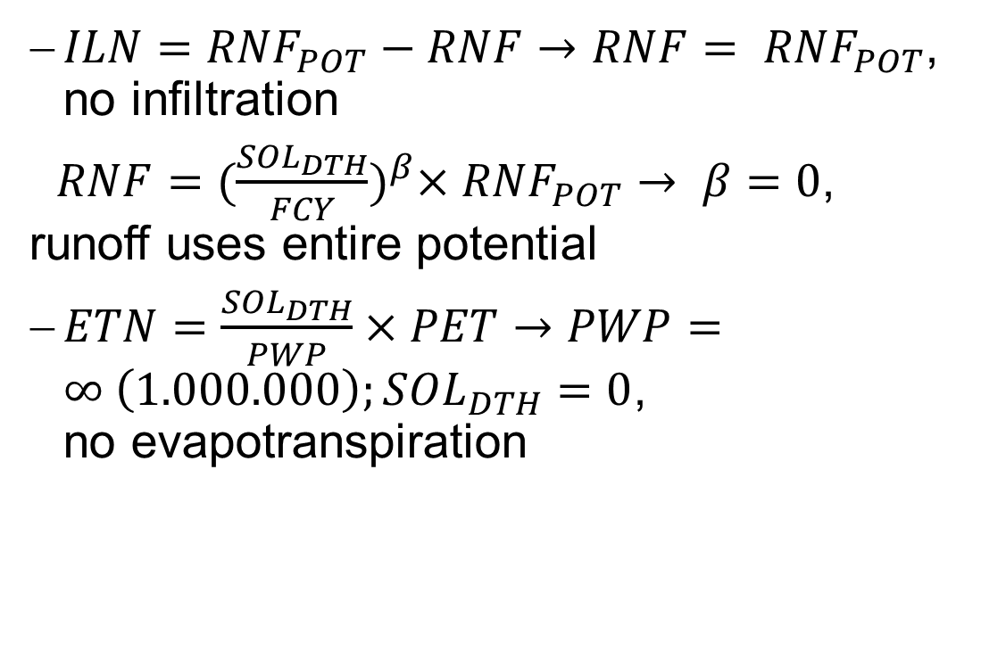
Equations
$ILN={RNF}_{POT}−RNF→RNF= {RNF}_{POT}$, no infiltration
$RNF{=(\frac{{SOL}_{DTH}}{FCY})}^{β}×{RNF}_{POT}→ β=0$, runoff uses entire potential
$ETN=\frac{{SOL}_{DTH}}{PWP}×PET→PWP=∞ \left(1.000.000\right);{SOL}_{DTH}=0$, no evapotranspiration

Slide 11
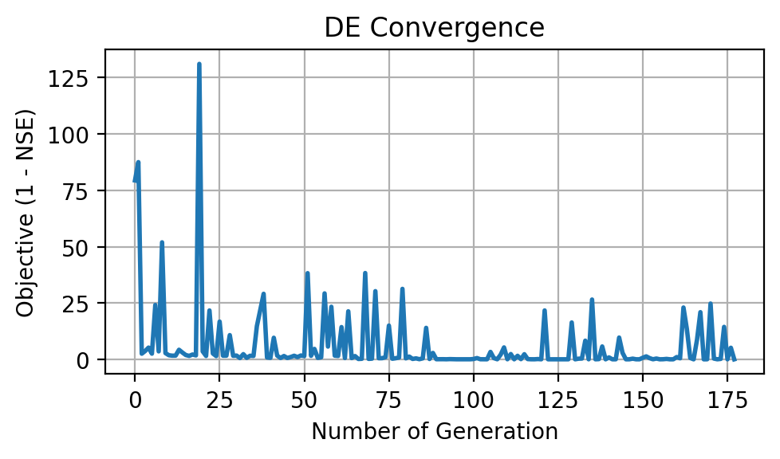
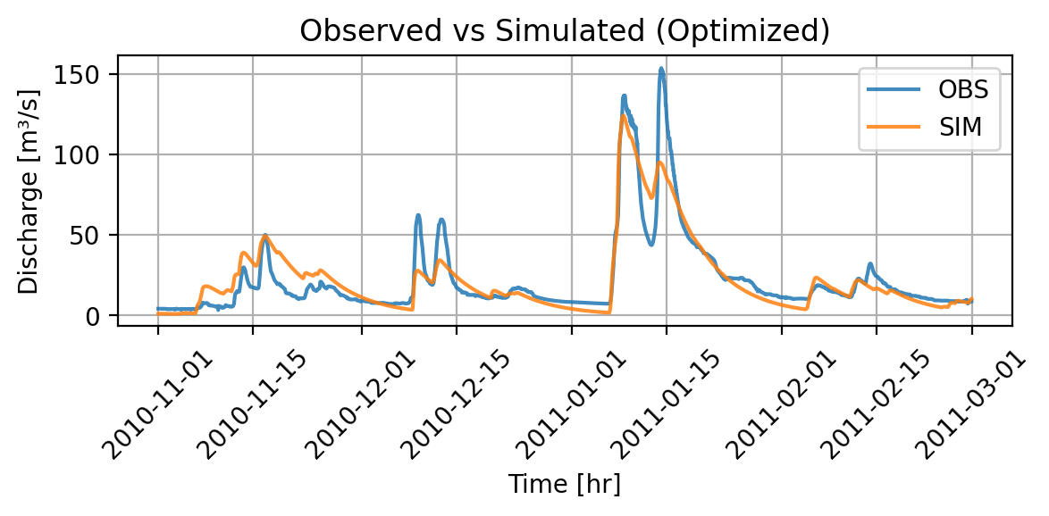
Results
NSE = 0.843
Slightly worse NSE
Implies no big impact of Evapotranspiration and Infliltration
Model runtime = 3.85 minutes
Max iterations: Fluctuating

Slide 12
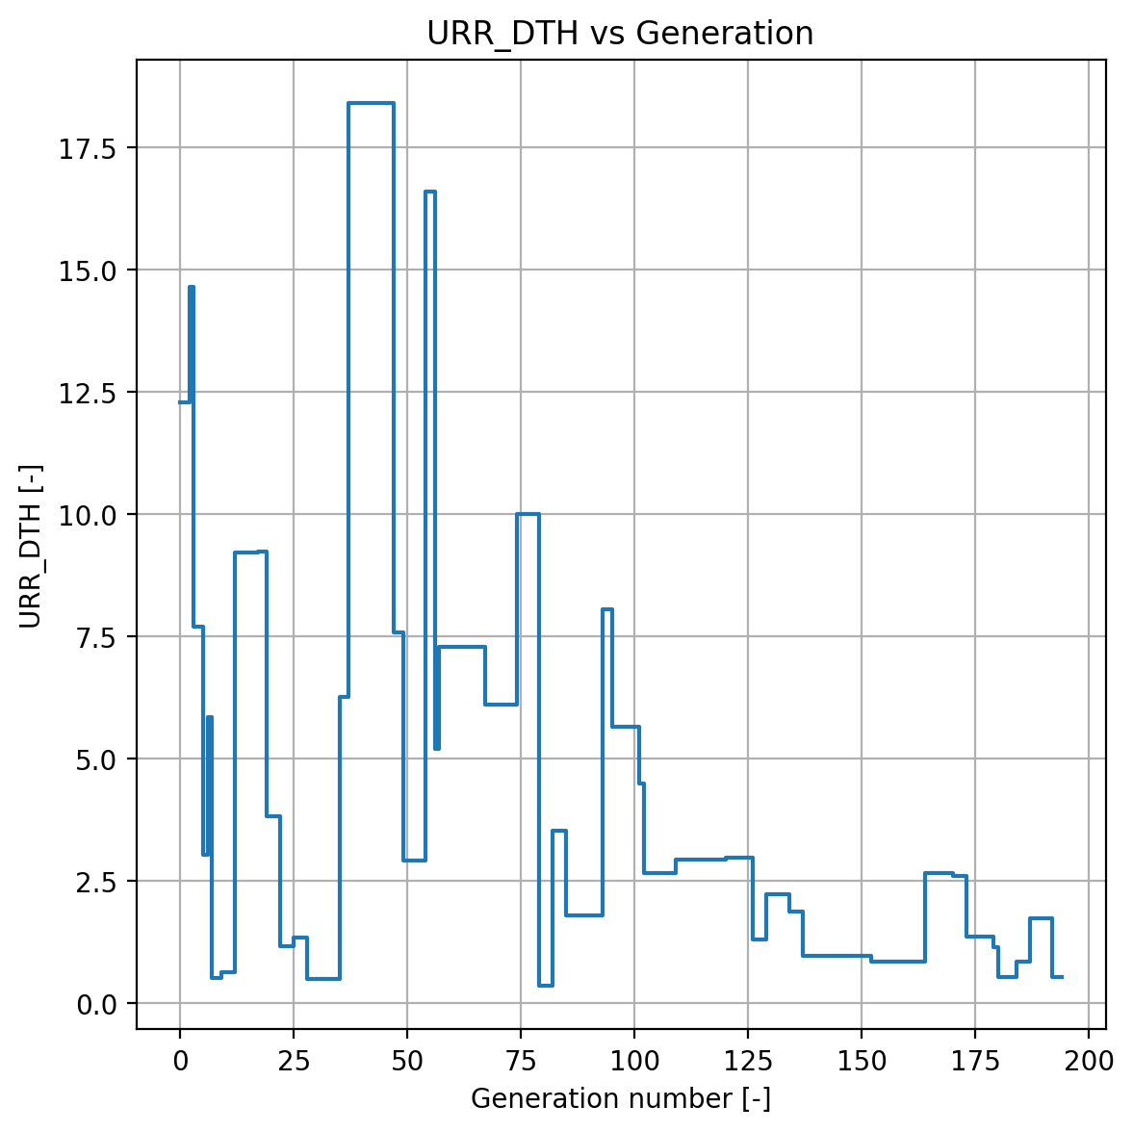
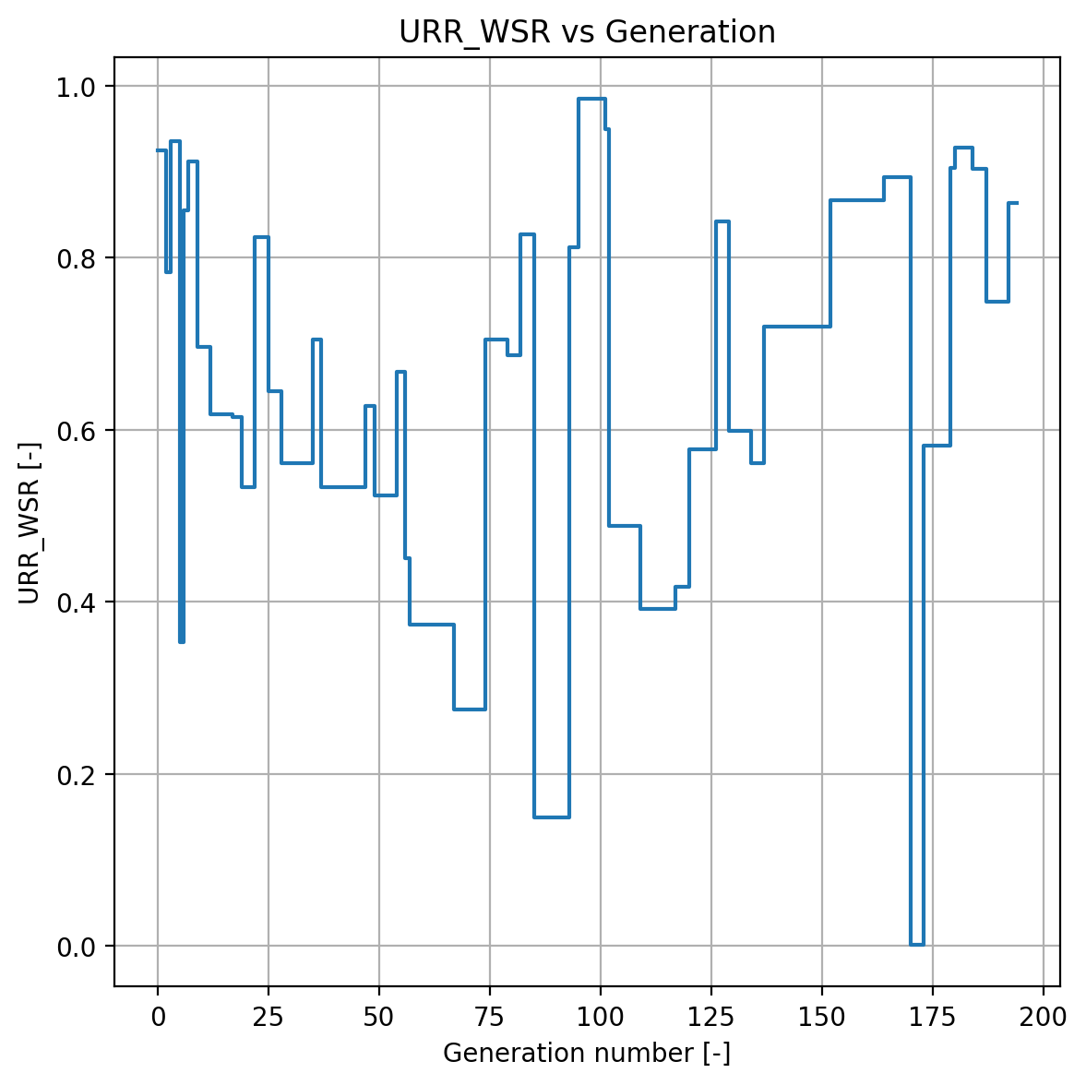
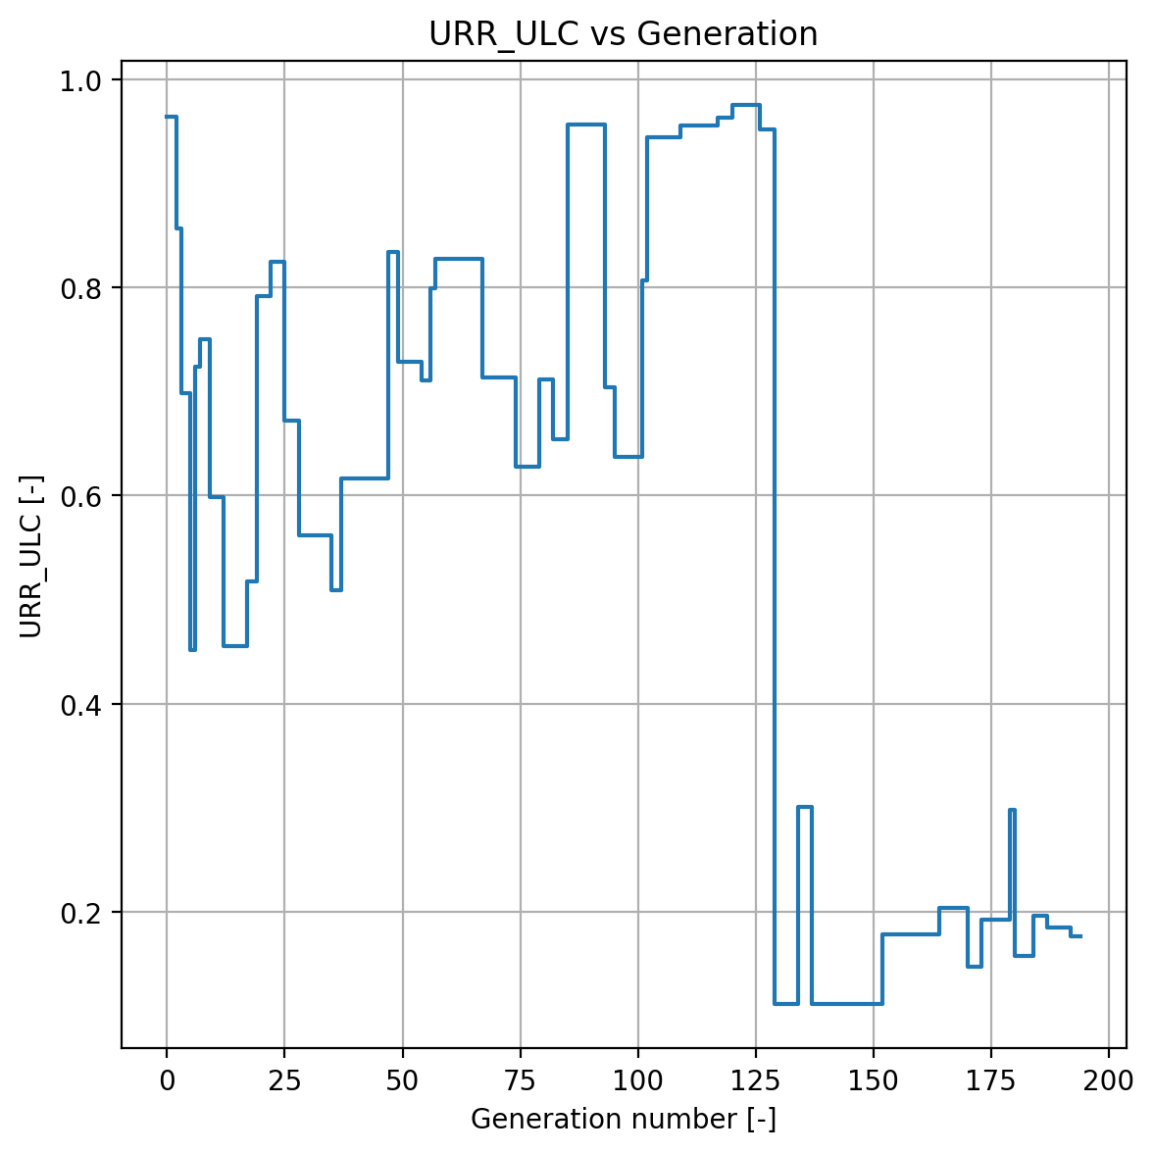
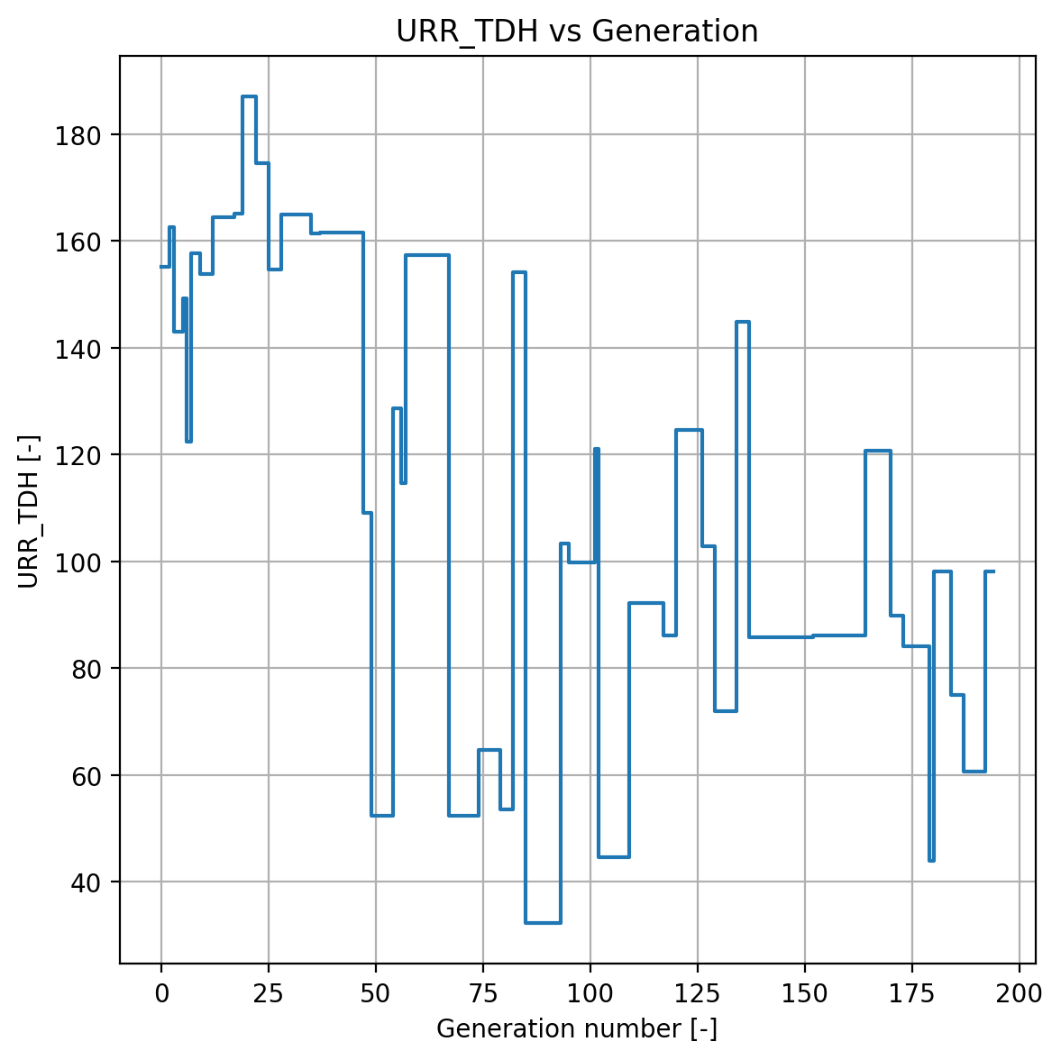
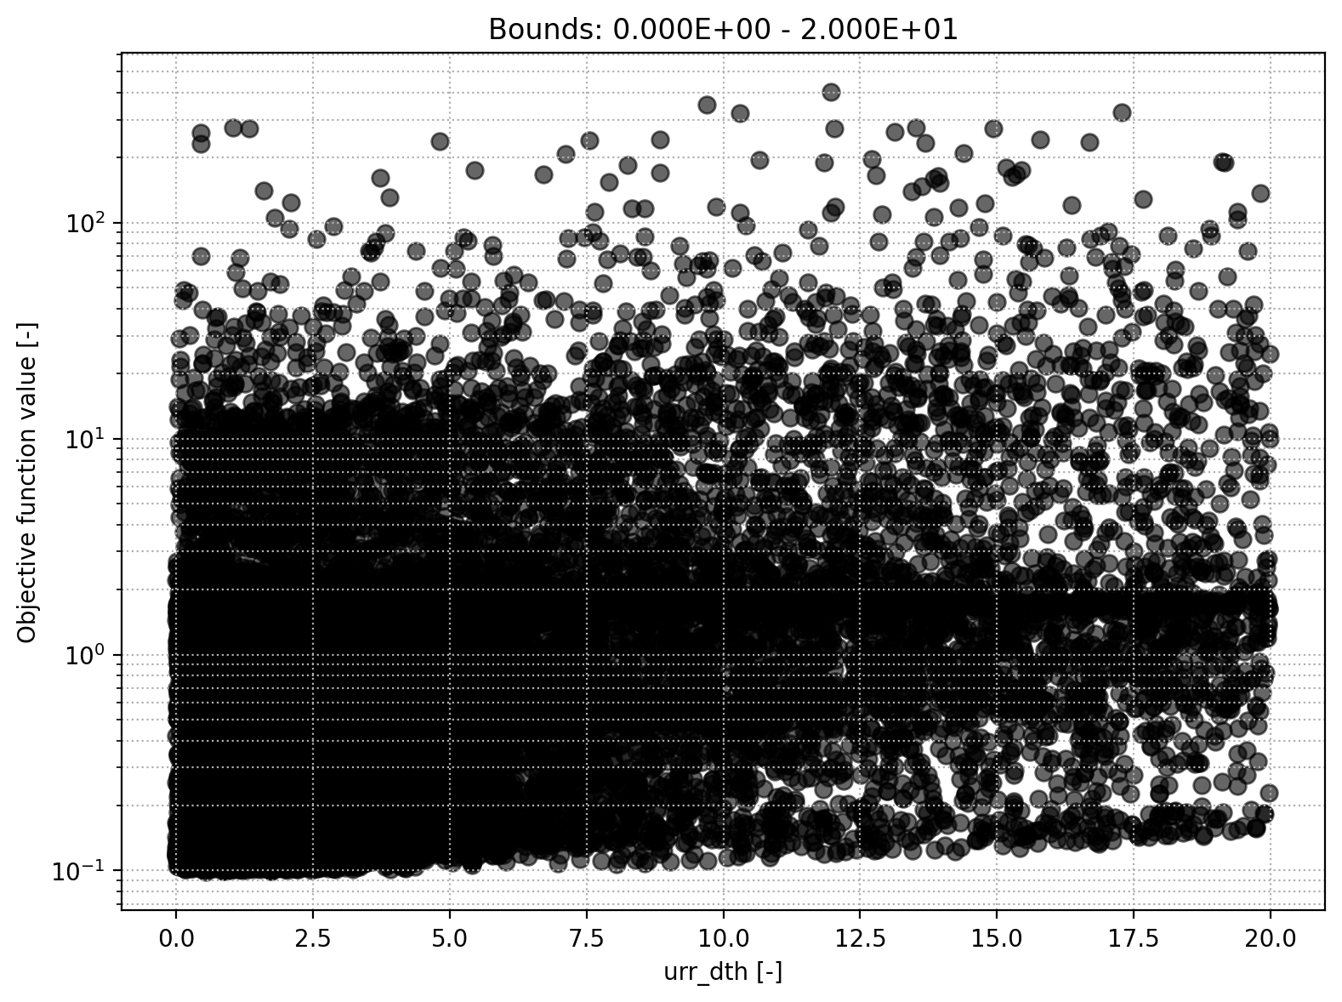
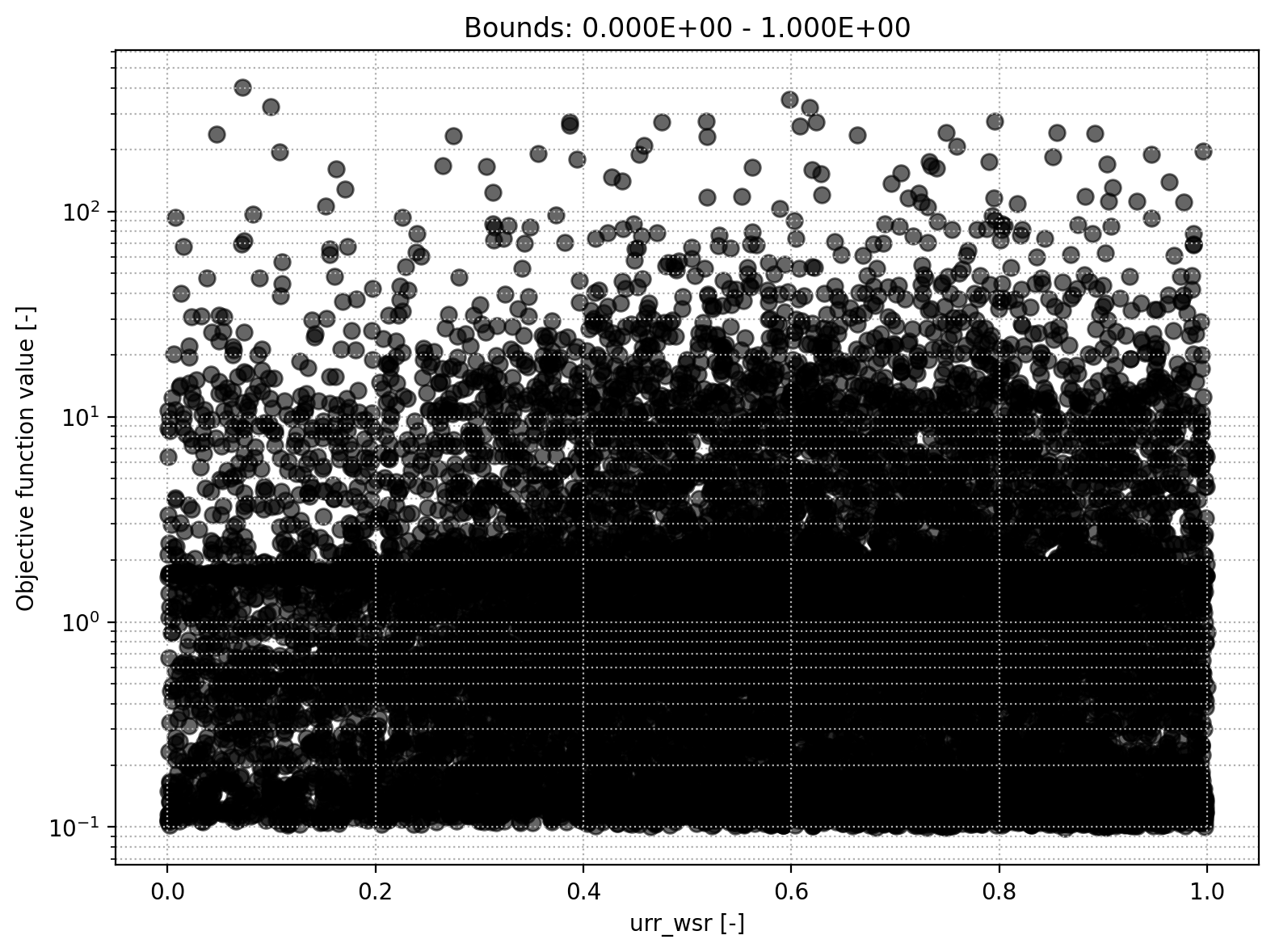
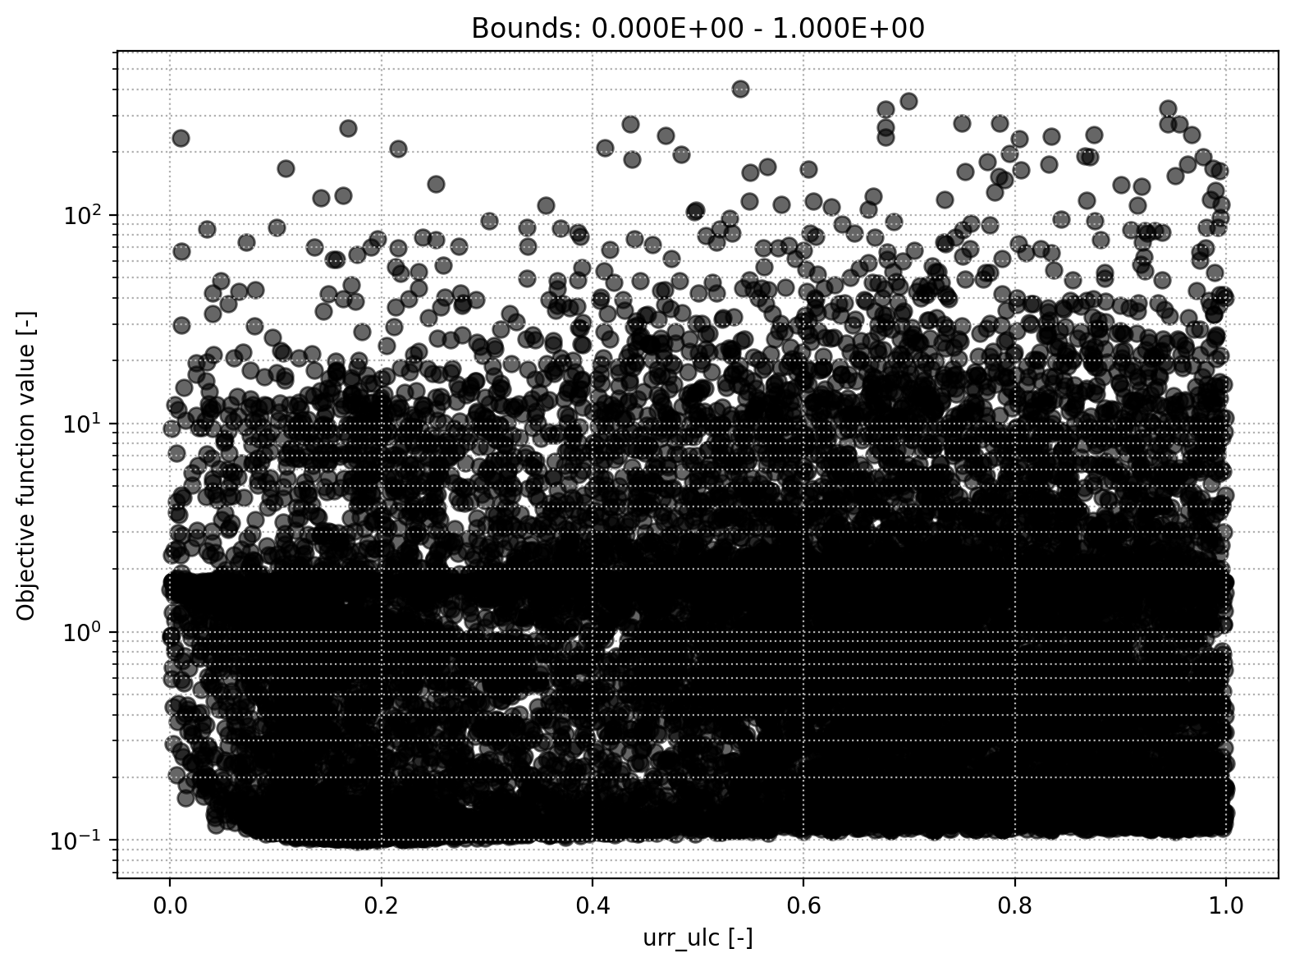
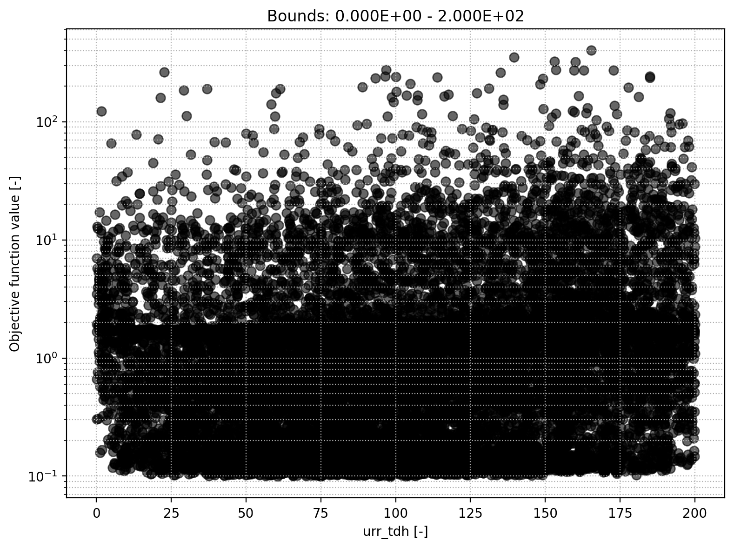
URR module
Storage initial upper reservoir
Upper-ers. runoff split ratio
Percolation coefficient upper-to-lower
Upper-res. threshold depth

Slide 13
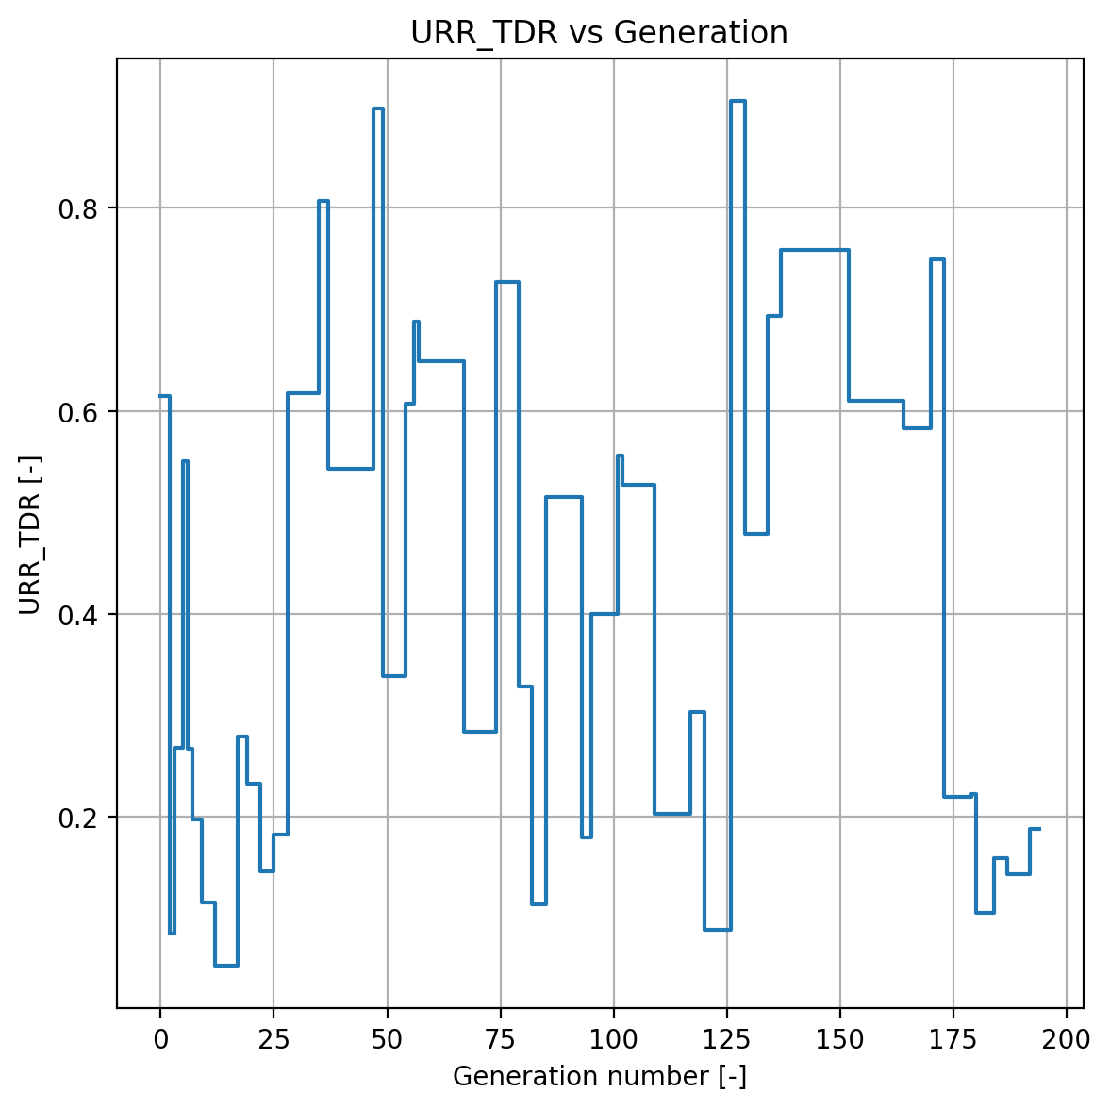
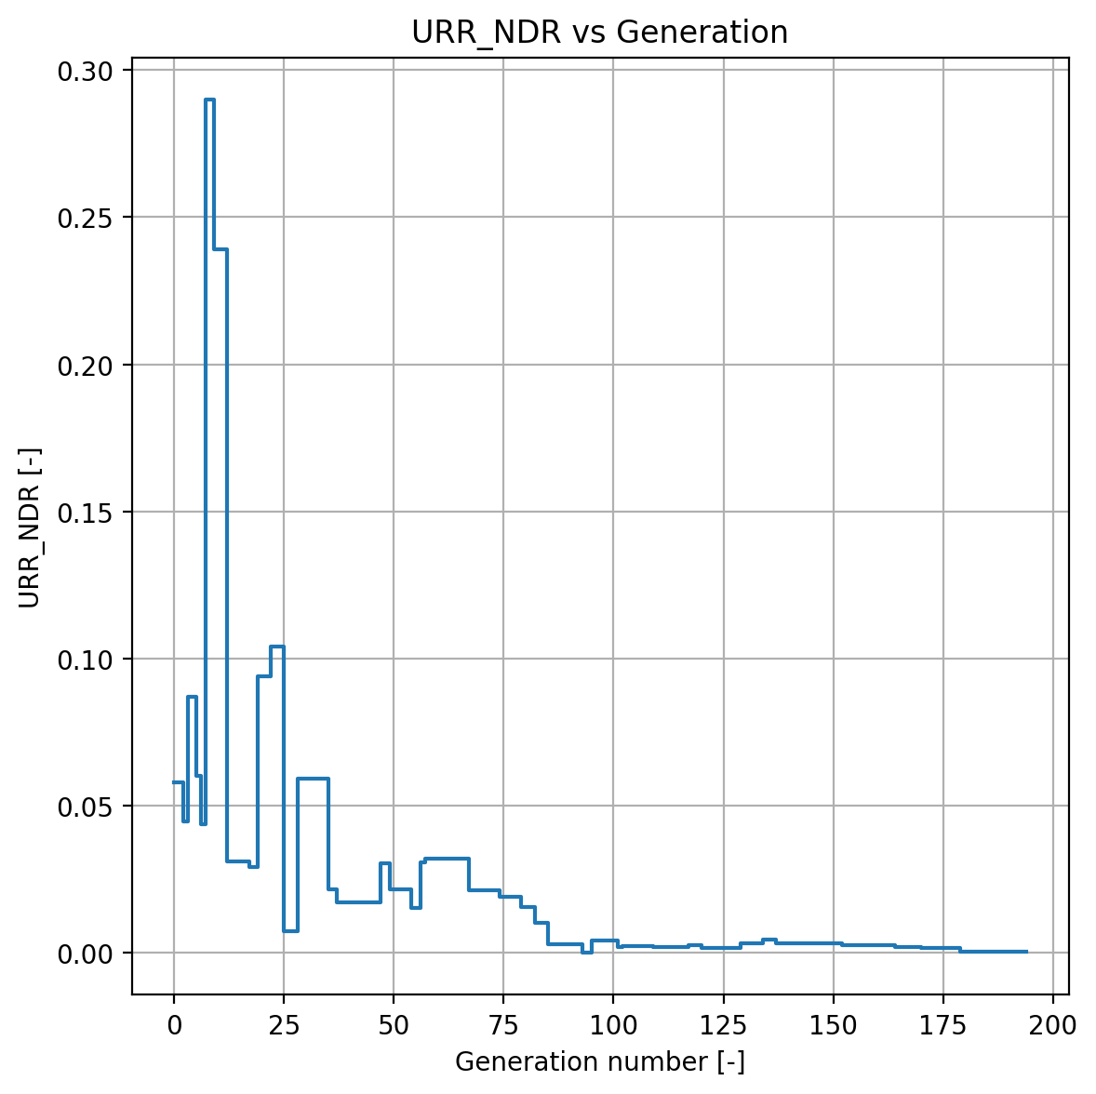
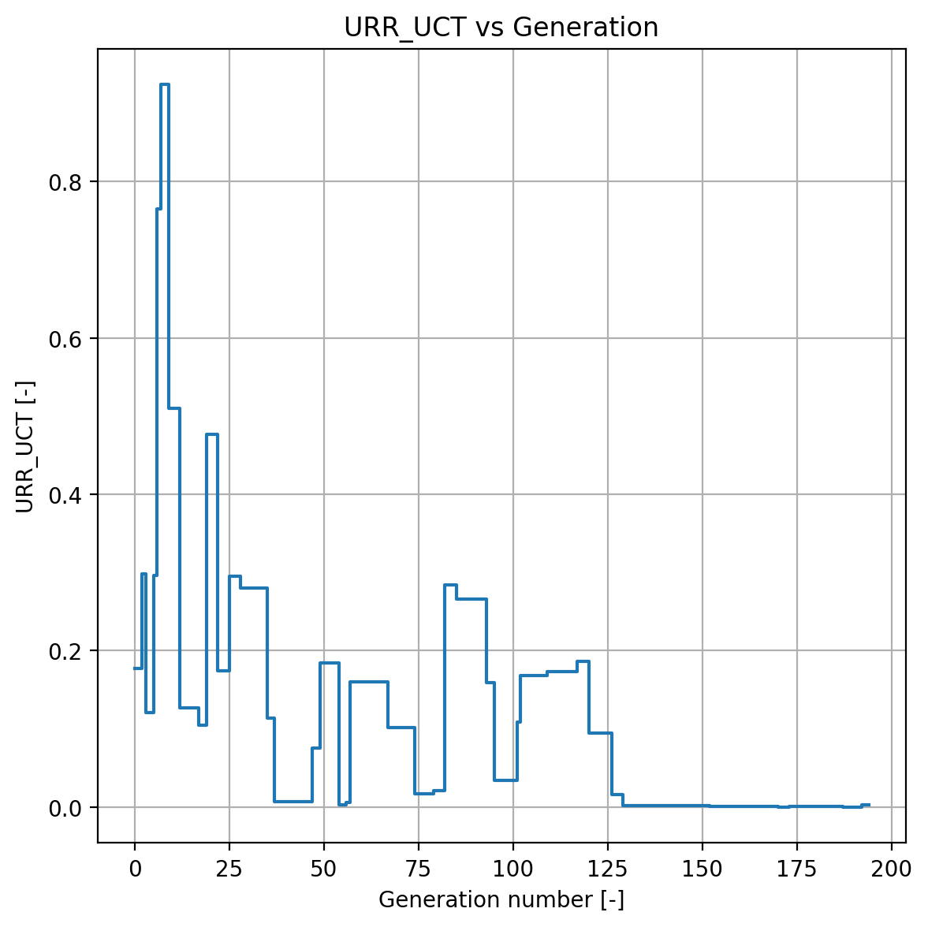
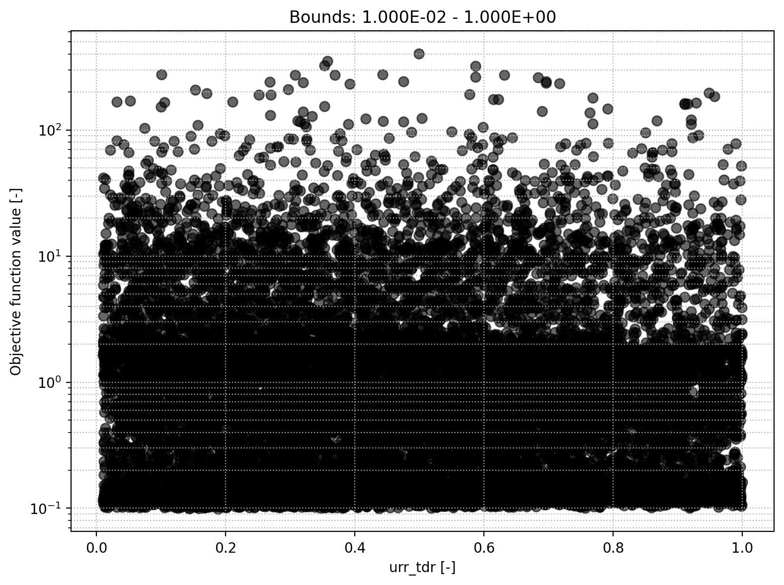
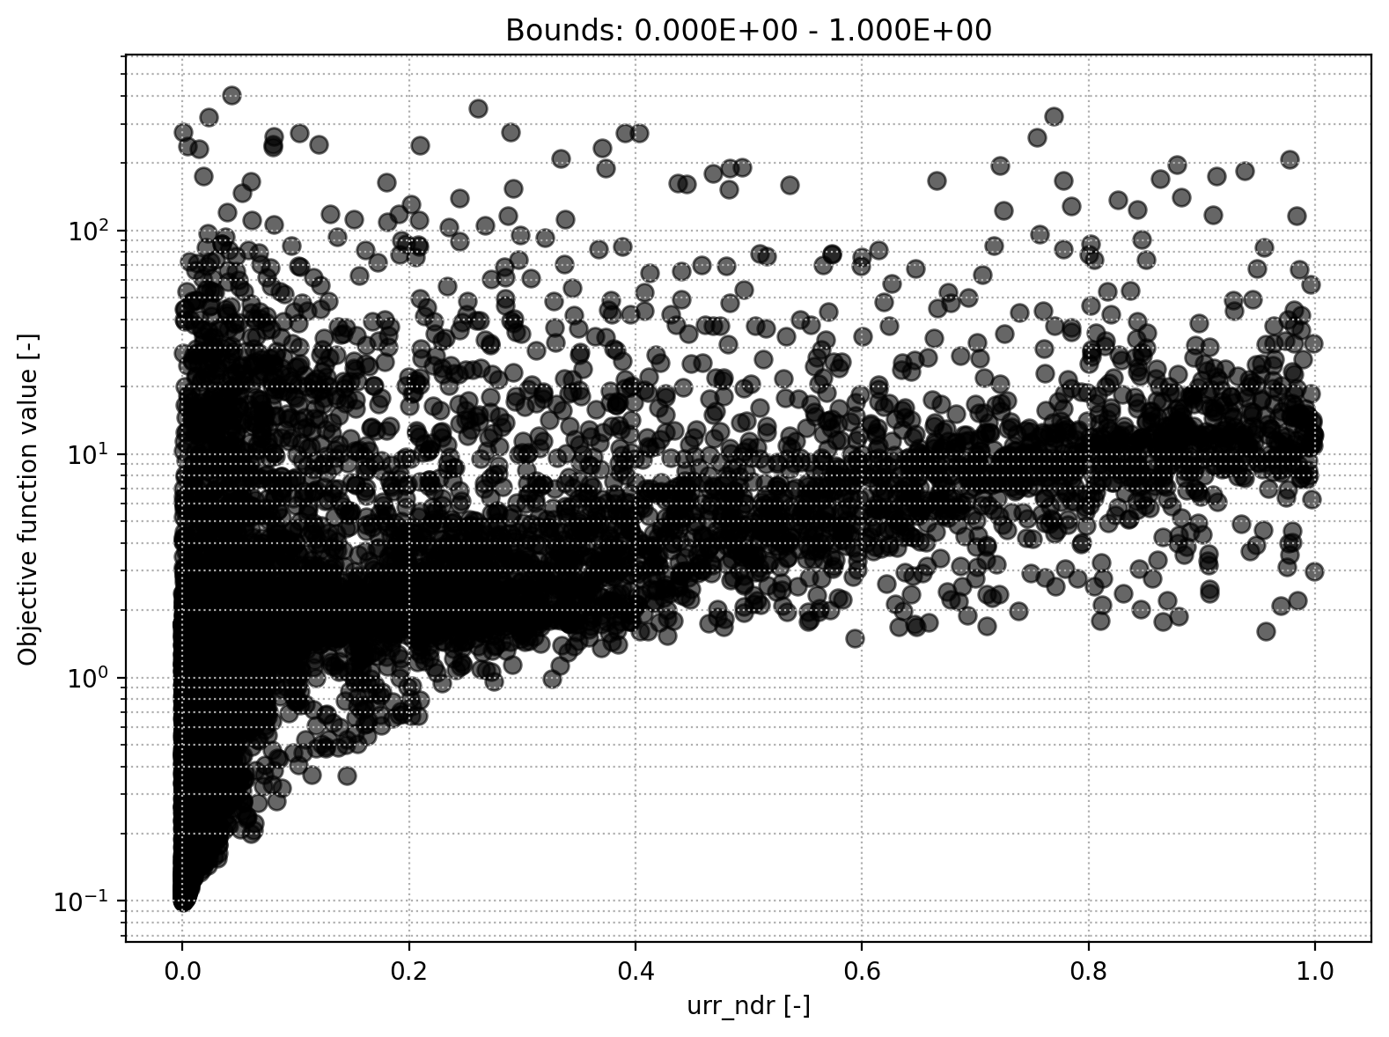
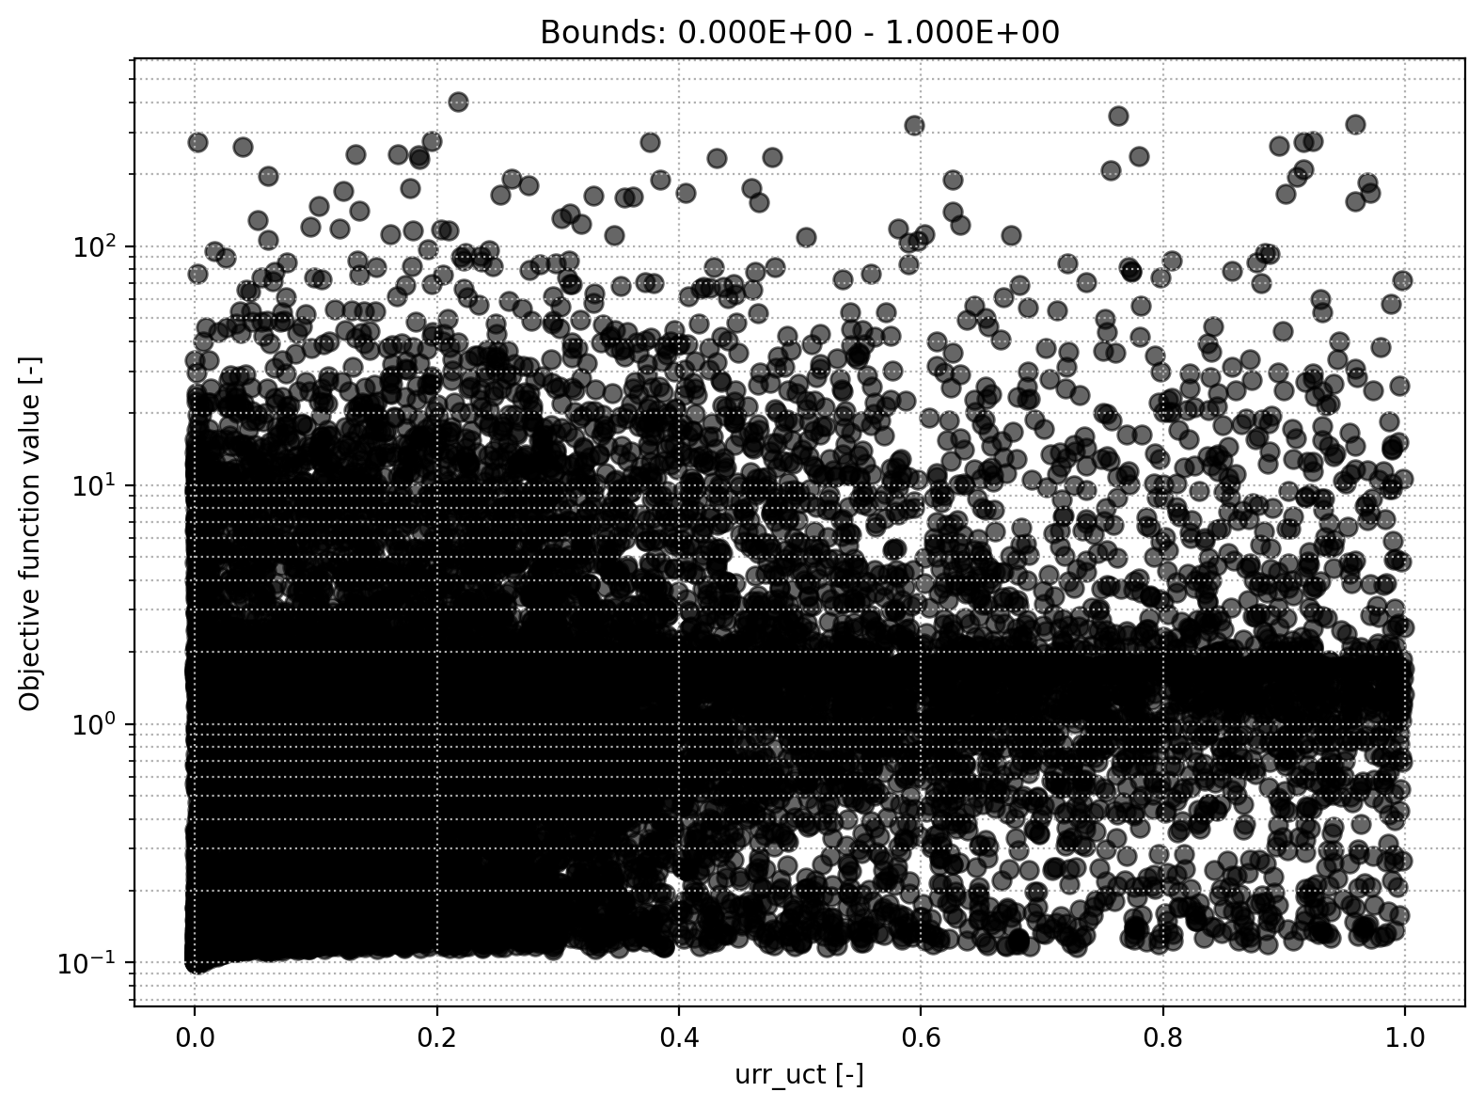
URR module
Upper-res. threshold coefficient
Upper-res. discharge to runoff coefficient
Upper-res. runoff coefficient

Slide 14
Upper Reservoir module off - optimization
𝑈𝑅𝑅_𝐷𝑇𝐻 = 𝑈𝑅𝑅_𝐷𝑇𝐻 + ((1 − 𝑊𝑆𝑅) × 𝑅𝑁𝐹)
𝑄_𝑇 = (𝑈𝑅𝑅_𝐷𝑇𝐻 − 𝑈𝑅𝑅_𝑇𝐷𝐻) × 𝑇𝐷𝑅
𝑄_𝑇 = 𝑀ax (𝑄𝑇 , 0)
𝑈𝑅𝑅_𝐷𝑇𝐻 = 𝑈𝑅𝑅_𝐷𝑇𝐻 − 𝑄𝑇
𝑄_𝑁 = Min (𝑈𝑅𝑅_𝐷𝑇𝐻, 𝑈𝑅𝑅_𝑇𝐷𝐻) × 𝑁𝐷𝑅
𝑈𝑅𝑅_𝐷𝑇𝐻 = 𝑈𝑅𝑅_𝐷𝑇𝐻 − 𝑄𝑁
𝑃𝐿𝑁 = 𝑈𝑅𝑅_𝐷𝑇𝐻 × 𝑈𝐿𝐶
𝑈𝑅𝑅_𝐷𝑇𝐻 = 𝑈𝑅𝑅_𝐷𝑇𝐻 − 𝑃𝐿𝑁
WSR=0 → All runoff enters URR
URR_TDH=0 → No storage threshold
TDR=1 → Fully open quick outlet
NDR=0, ULC=0 → No interflow
Result:
QT=RNF, QN=0, PLN=0
All inflow immediately becomes quickflow — URR behaves as if bypassed to river.
WSR = 0
URR_TDH​ = very large (≈1000)
TDR=0, NDR=0
ULC=1
Result:
PLN=RNF,Q_T=0,Q_N=0
URR acts as a pass-through to LRR, with no direct quickflow.

Slide 15


Upper Reservoir module off – optimization 1
WSR=0 → All runoff enters URR
URR_TDH=0 → No storage threshold
TDR=1 → Fully open quick outlet
NDR=0, ULC=0 → No interflow
Result:
QT=RNF, QN=0, PLN=0
All inflow immediately becomes quickflow — URR behaves as if bypassed to river.
NSE = -0.1175

Slide 16

Upper Reservoir module off – optimization 2
WSR = 0
URR_TDH​ = very large (≈1000)
TDR=0, NDR=0
ULC=1
Result:
PLN=RNF,Q_T=0,Q_N=0
URR acts as a pass-through to LRR, with no direct quickflow.
NSE = 0.8874

Slide 17




LRR module
Storage initial lower reservoir
Discharge rate

Slide 18


Lower Reservoir module off – optimization
NSE = -0.1039
𝑄𝐿 = 𝐿𝑅𝑅_𝐷𝑇𝐻 × 𝐷𝑅𝐸 DRE = 0, ULC = 0, TDR = 1 (from the upper reservoir)
𝐿𝑅𝑅_𝐷𝑇𝐻 = 𝐿𝑅𝑅_𝐷𝑇𝐻 − 𝑄𝐿
𝐿𝑅𝑅_𝐷𝑇𝐻 = 𝐿𝑅𝑅_𝐷𝑇𝐻 + 𝑃𝐿𝑁

Slide 19


LRR module
Lower-res. runoff coefficient

